Slide 1
Better Solutions™
REMIT 10 Inc. SmartGarden App
COSC368 Assignment 1 Design Concepts
Authors:
Mel Cresswell mcr71 86362156
Isabelle Lynch irl18 32346428
Nicole Steinke nst44 46721931
Alexis Sy mas264 21229382
Thomas Eatson twe29 87733326

Slide 2
Executive Summary/Abstract
The purpose of this presentation is to highlight the concepts produced in the design process for the REMIT 10 Inc. SmartGarden App.
This presentation provides an analysis of user needs and tasks, which have been used to develop a range of possible sketch based design solutions generated by the Better Solutions™ team. Alternative designs were evaluated by assessing the relative merits and determining the risks associated with each design. A primary preliminary design was then implemented through the use of pros and cons of each preliminary design alternative and final sketches were produced to represent the features of the application.
This final design makes use of the REMIT 10 patented smart protocols to provide a main resource for users to interact with their smart gardens.

Slide 3
Introduction
With an emerging market for integrated control and monitoring of ‘smart-gardens’, REMIT 10 Inc, an international gardening-supplies company, is exploring the option to provide an application which interacts with smart-gardens including small hydroponic centres. Through the use of smart protocols patented by REMIT 10, the application is intended to make use of a wide range of garden sensors and actuators installed in a user’s garden which provide a basic description of their capabilities, status and precise locations. Sensors that detect factors such as temperature, rainfall, pH levels and humidity will be used to provide users with detailed garden statistics for both present and past conditions, as well predictions for future conditions and weather forecasts. The application will also allow users to activate and control heating, lighting and shading capabilities as well as water and feed systems to differing garden components.
In order to satisfy the requirements of the REMIT 10’s CEO, numerous stages of the design process have been carried out shown in slides following. These include identifying a number of scenarios to represent common situations which potential REMIT 10 smart-garden customers could be faced with and categorising those user tasks. These tasks and scenarios were then further analysed by determining their frequency and importance. Using the results from this analysis, a range of possible sketch based design solutions were generated and evaluated against each other. A primary design suggestion was then developed using the best aspects of these initial designs in order to produce the most successful solution that gives the company a competitive advantage and improves user experience.

Slide 4
User and Task Identification - Scenarios
Scenario 1:
Steve has a summer bach in Taupo and wants to make sure his garden is maintained throughout the year so that when he brings his family up in summer it is still looks beautiful and the plants have not died. He wants to be informed of how his garden is growing while they are away to make sure that he and his family can enjoy the garden views while on holiday.
Scenario 2:
Megan has been given the task of trialing a hydroponic garden for a produce company which she works for. Megan thinks this would be a great venture for the company and really wants to the trial to be successful so would like to carefully monitor the garden. She wants to monitor the water and energy consumption, set nutrient feeder timers, and view the temperature, humidity, and sunlight. Megan’s bosses and colleagues also want to be able to track the progress of the hydroponic garden trial along with all their other gardens.
Scenario 3:
Barry is a young entrepreneur who wants to grow and sell fruit and vegetables at the local farmers market. He wants to make as much return on his sales as possible so does not want to be wasting unnecessary amounts of feed and fertilizer which are costly for Barry. He wants maximum detail about feeding the plants, soil information and energy use.

Slide 5
User and Task Identification - Scenarios
Scenario 4:
Mary is an avid gardener, but as a 70 year old is physically challenged and uses a walking apparatus. She would like a system that keeps her informed of her garden and allows her to maintain her garden without having to maneuver around it and do back breaking work. She also wants a system that is easy for her to use and understand with her minimal experience with technology
Scenario 5:
Lucy is a busy business woman, running a flower empire/garden designing company. She wants her many flowers and shrubs to be watered at 8 am unless it rained overnight. Lucy is normally at work at this time and so can not water the flowers herself. Lucy also wants to know what the expected temperature for overnight is, whether there will be a frost which will destroy her precious flowers, or not. Lucy also has a greenhouse where she grows all her flowers both to use for garden designing and to sell commercially. Lucy wants to keep track of how much sunlight the flowers get, and wants to automatically water and feed them.
Scenario 6:
Greg is primary school teacher who wants to teach his students about taking care of a garden and wants the students to have the joy of eating their hard earned produce. Greg wants to show such data like rainfall, sunlight and growth progression to his students. Richard is the caretaker who looks after the garden and needs to be able to control sprinklers, view pH levels and check moisture content so the garden doesn’t die while the kids are on holiday.

Slide 6
User and Task Identification - Categories of Tasks
The following lists describe the numerous tasks that are of importance to the potential application users, categorised by a related element or topic.
Water:
Turn all sprinklers or individual zone sprinklers on and off
Set timer for sprinklers to turn on at a specific time and to turn off at another specific time and also automatically turn itself off when weather forecast dictates (ie. turn off sprinkler when it is raining)
Control the level of nutrient feeds in water system
Set timer for feeders to turn on at a specific time and turn off at another specific time
View moisture levels of soil
View rainfall levels
Air:
Open all windows or individual zone windows to control airflow (specific task for indoor gardens)
Set timer for windows to turn open at a specific time and close at another specific time
View humidity levels of air around garden
Turn all heaters or individual zone heaters on and off (specific task for indoor gardens)
Set timer for heaters to turn on at a specific time and turn off at another specific time (specific task for indoor gardens)
Adjust the heating level (specific task for indoor gardens)

Slide 7
User and Task Identification - Categories of Tasks
Light:
Turn all lights or individual zone lights on and off (specific task for indoor gardens with minimal natural light)
Set timer for lights to turn on at a specific time and turn off at another specific time (specific task for indoor gardens with minimal natural light)
Adjust the brightness of lights (specific task for indoor gardens with minimal natural light)
Control shaders to block out natural light
Set timer for shaders to turn on at a specific time and turn off at another specific time
Track and view amount of sunlight
Soil:
View pH levels
View nutrient levels
Control the level of fertilizer being feeded
Set timer for fertilizer feeders to turn on at a specific time and turn off at another specific time
Information:
View weather forecast for future and current days
Gardening tips e.g. what time of year to plant specific plants, what time of the year to prune plants
Log of specific plants - plug in plant type and date to get estimate of how far along they will be
View weeding reminders

Slide 8
User and Task Identification - Frequency Analysis
The following table shows each task identified in the previous slides, ranked on how frequently they are carried out and how important they are to the user.
~Tasks~ | Less important | More important
Infrequent | Information 2, 3, 4 | Water 5, 6 Air 3 Light 6 Soil 1, 2
Frequent | Water 2, 4 Air 2, 5 Light 2, 5 Soil 4 | Water 1, 3 Air 1, 4, 6 Light 1, 3, 4 Soil 3 Information 1

Slide 9
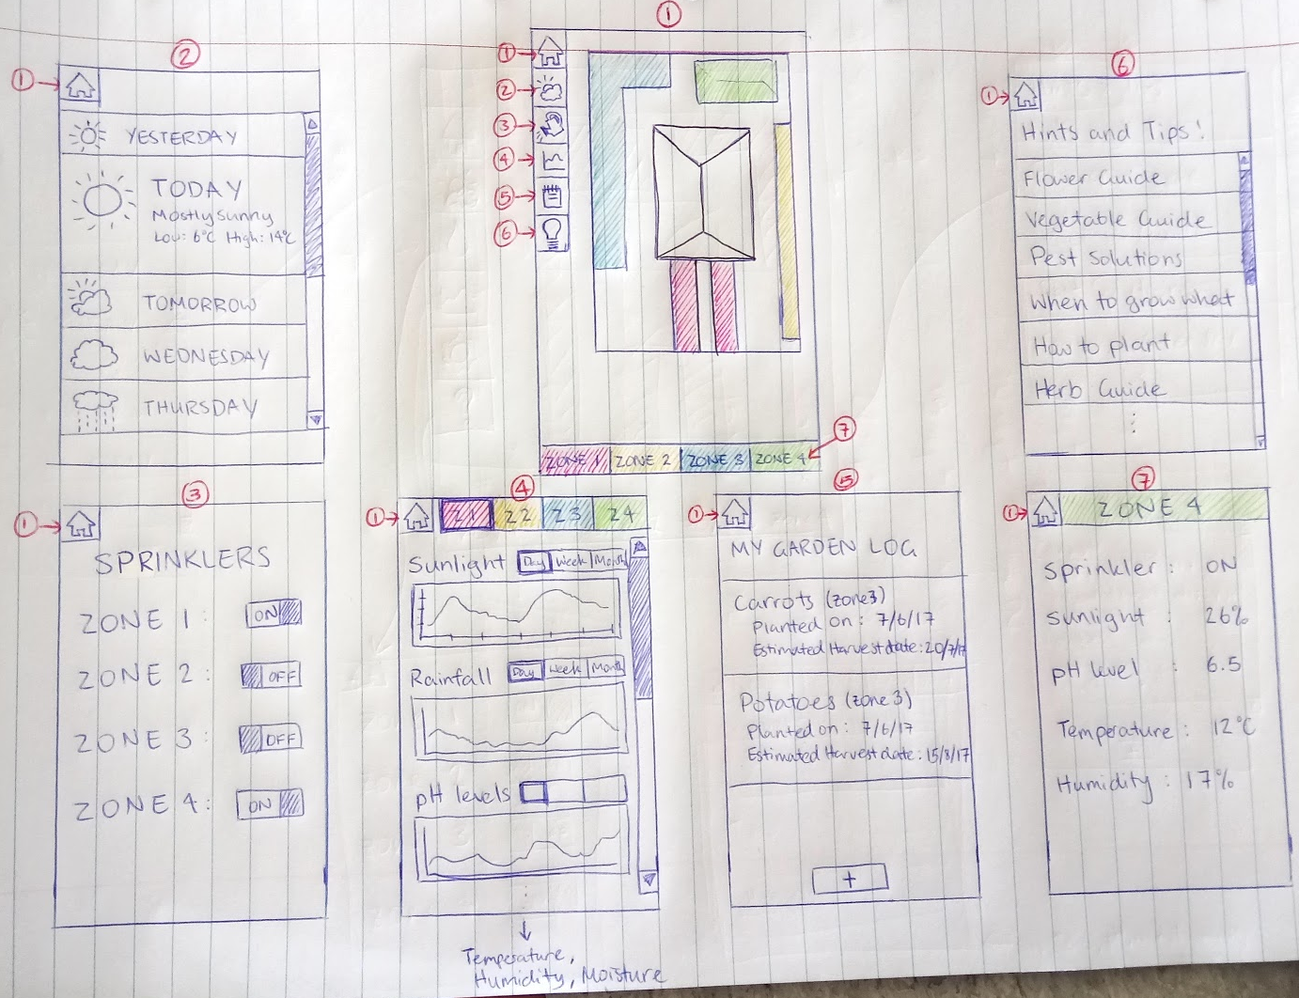
Preliminary Design Alternatives - Design 1
Home screen: Shows the bird's eye view of the garden, clicking a zone goes to (7).
Weather: When a day is clicked, it expands to show more detail like the expected low and high of the day
Sprinklers: Can turn on and off the sprinklers in each zone.
Statistics: Able to view the data by day, week, or month.
Log: Shows a list of activities completed by the user.
Hints & Tips: Has a list of guides for gardening.
Zone description: Shows a live overview of data from the sensors in the given zone.

Slide 10
Preliminary Design Alternatives - Design 1
Pros | Cons
Can view each zone easily, with matching colours for each identified zone Can see all features of each particular zone Quick zone summary available | Home picture of house may need to be changed if the user wants to switch around zones - requires extra feature that is not necessary Can’t set timer for sprinklers, only on and off Can’t compare sunlight/rain/etc in different zones
Risks: forgetting to turn sprinklers off so they just stay on and flood that zone - could be fixed with timers.
This design would be good for scenario 4 because the log helps Mary keep track of how far along plants are, and the sprinklers are able to be turned on and off from her device.
This design would be good for scenario 6 because it lets the kids keep track of when they planted their vegetables, and allows different zones for different classes.
This design would not work for scenarios 1 or 5 because it doesn’t have a timer system attached to the sprinklers.

Slide 11
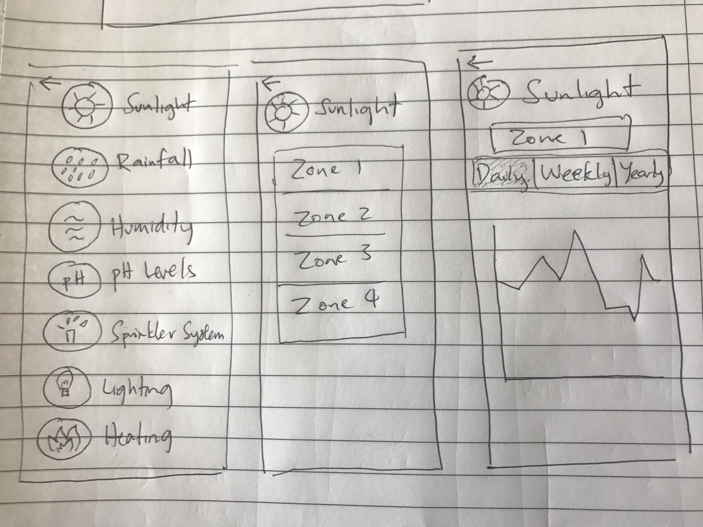
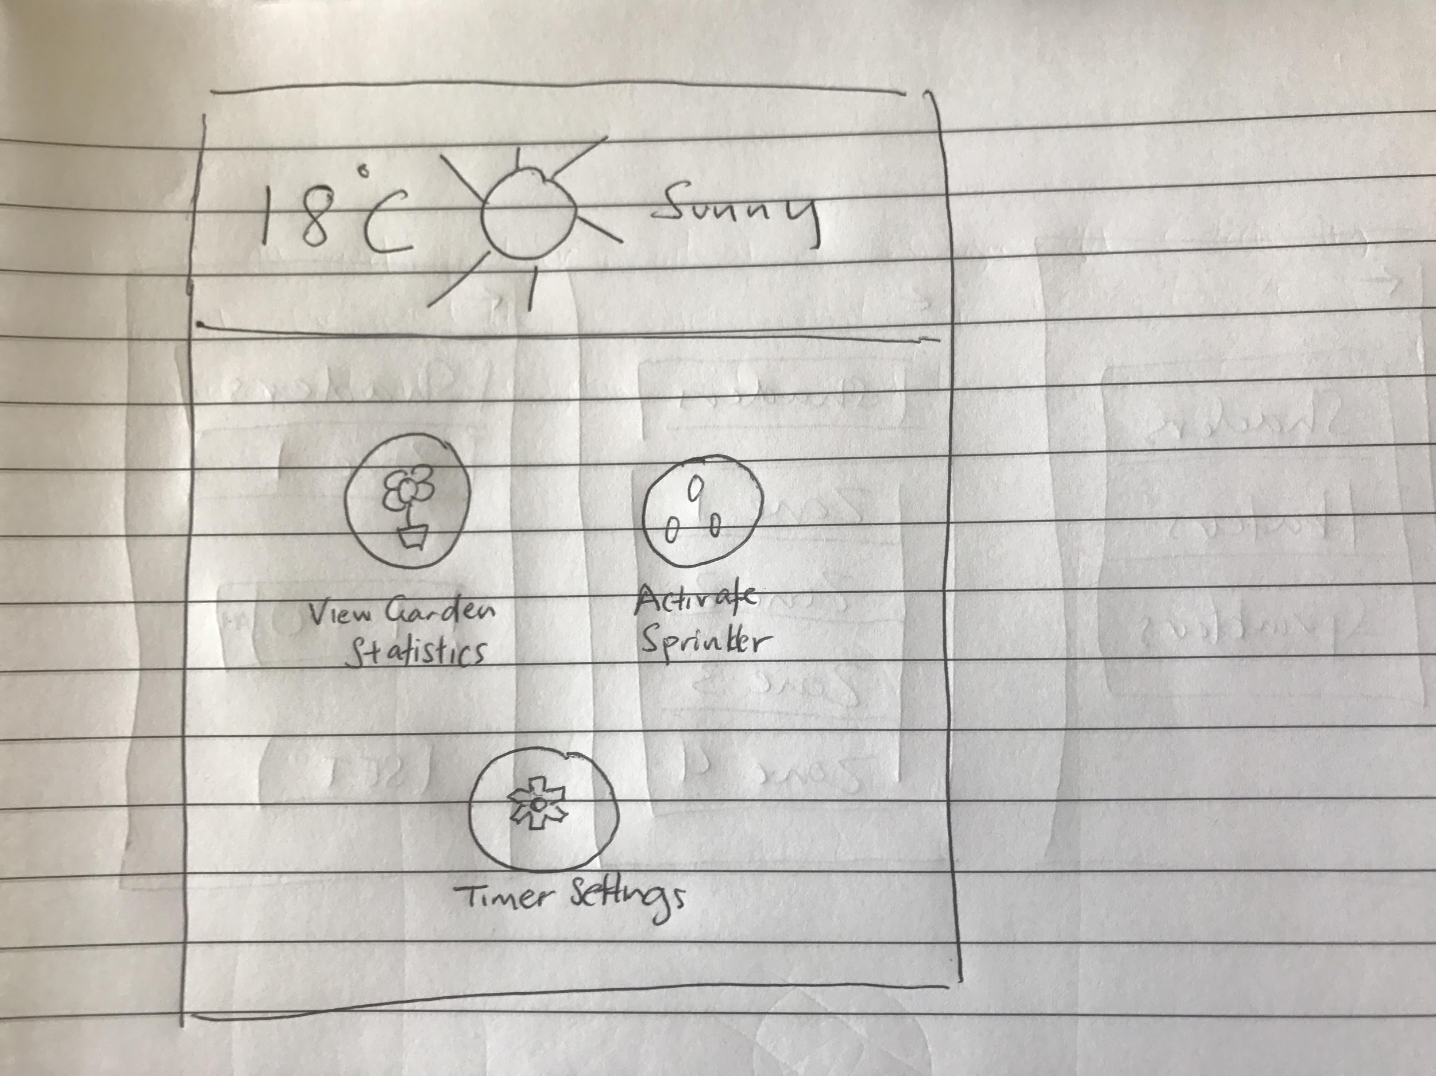
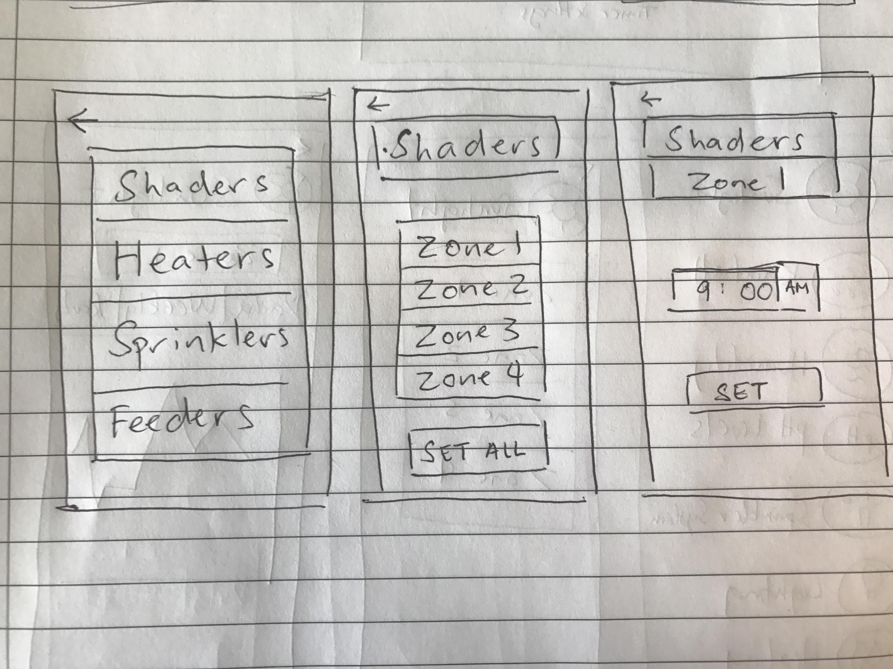
Preliminary Design Alternatives - Design 2
Headings so the users know what page they are on
Back option for all subsequent pages that is not the homepage
Change data information to daily, weekly or yearly when clicked
Quick view of current weather
Graph displayed of accumulated data
Picture icons for ease of use/easy to familiarise users, click icons or text to go to specified pages
Quick access to enable sprinkler,
Click again to turn off sprinkler
Timer scroll option to set timer for specific feature on at a specified time.
When Set button is clicked, the timer is set and the label changes to disable, to disable the timer, click again, looping around the two labels when clicked

Slide 12
Preliminary Design Alternatives - Design 2
Pros | Cons
Aesthetically pleasing with round pictorial buttons Option to view features in a daily/weekly/monthly/yearly graph - good to help view patterns across the day/year etc Sprinkler system button (most commonly used feature) on home page for easy access | Again unable to compare sunlight or different feature of different zones Sprinkler system button also under statistics menu - could confuse users Have to disable timers manually, users can easily forget to turn off timers
Risks: Accidentally clicking set all for shaders instead of one specific zone so no zones get sunlight that day and can set off sprinklers without realising it is set off as it is on the homepage with no warning feature that you are about to activate the sprinkler.
This design would be good for scenario 1 because of its simplistic design, Steve could use the features he wants without having to look at all the statistics.
It is also good for scenario 4 because Mary can easily use it and check statistics, and also set shade for her garden through the app without having to do it manually.
This design is not as good for scenarios 2 and 5 because it doesn’t have enough information/options for commercial use.

Slide 13
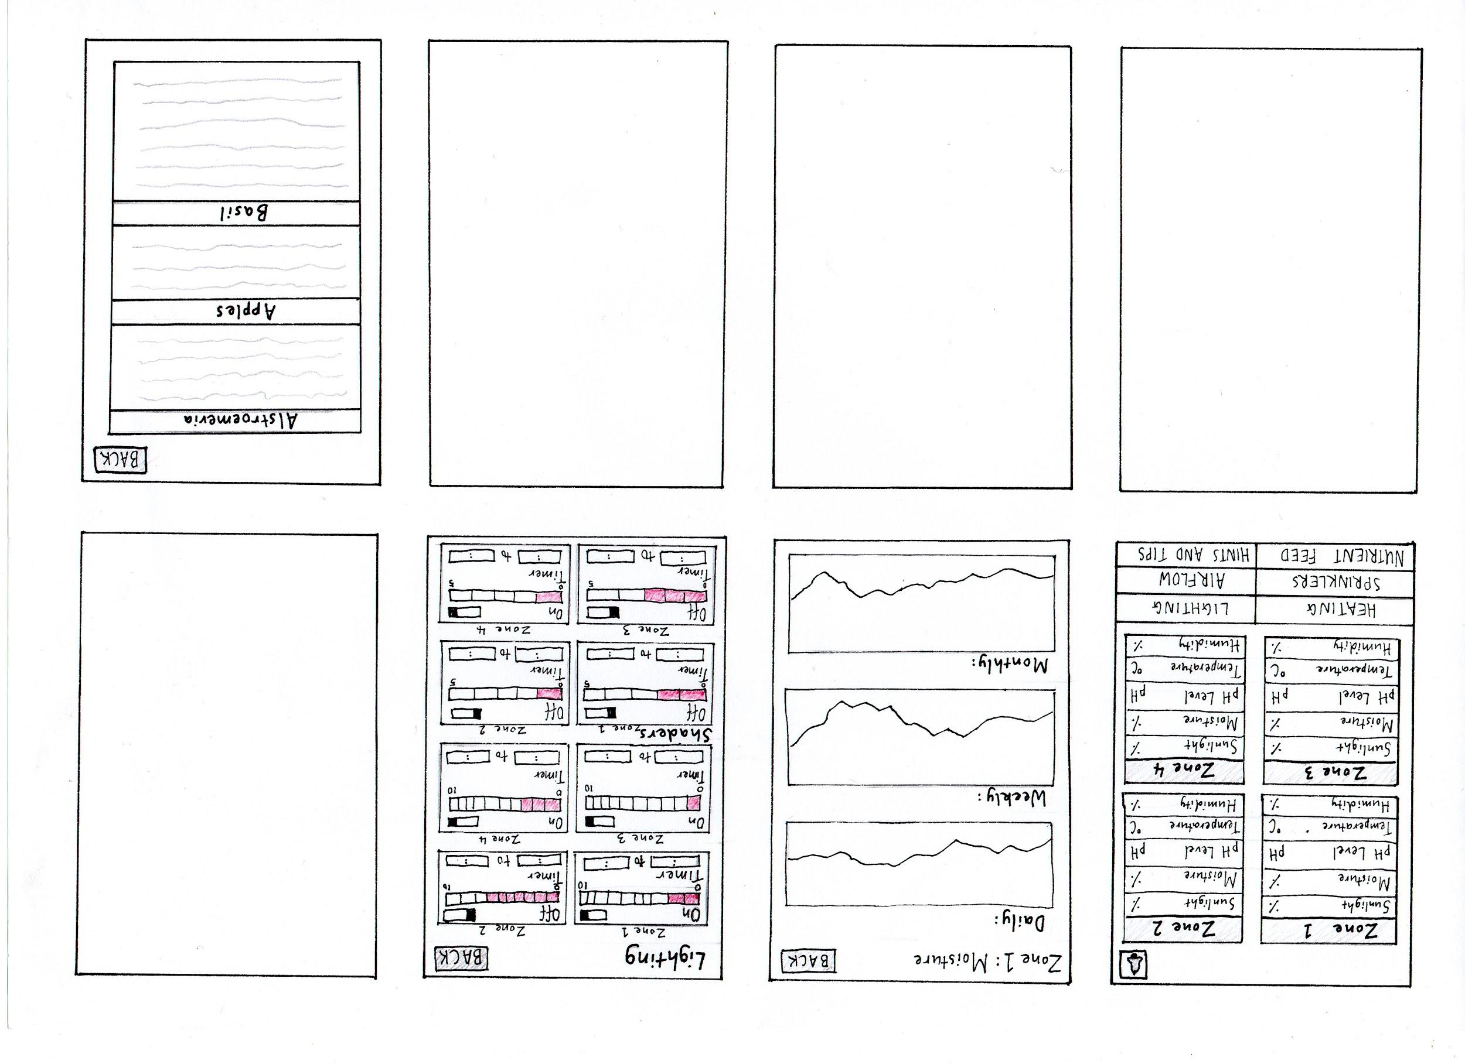
Preliminary Design Alternatives - Design 3
* Each page is vertically scrollable if there are more than four garden zones
Button to go back to home page
Notifications button activates pop-up box with weeding reminders
Button to go back to home page
Button to go back to home page
Sketch 3 - Example Statistics Page
(accessed from tapping 2)
Sketch 4 - Hints
and Tips Page
(accessed from tapping 3)
Sketch 1 - Home Page
(App Landing Page)
Sketch 2 - Example Controls Page
(accessed from tapping 1)
Zone summary statistics, detailed statistics pages accessible by tapping on each title (see sketch 3)
Buttons to controls pages
On/off button
Button to ‘Hints and Tips’ page
Vertically scrollable text box with relevant garden tips and information
User text input start and finish time
Touch range slider to set brightness/shade level
Time based statistics graphs
2
1
3

Slide 14
Preliminary Design Alternatives - Design 3
Pros | Cons
Controls heating and lighting - good for indoor gardens Weeding reminder can be seen easily to remind users Can compare features like sunlight/moisture/etc easily through the homepage Can adjust levels of heating, lighting, sprinkler, air flow and nutrient feed via sliders on their respective controls page | Not as practical for outdoor gardens since don’t need to control heating/airflow outside Busy home screen, which allows users to easily click through another page accidentally Not much flexibility when viewing statistics, like looking back at previous days, weeks and months May have to scroll through a lot on the hints and tips page to get to the information the user wants to view
Risks: Can’t predict rainfall/sunlight due to lack of weather forecast, so sprinklers could be on while already raining wasting water
This design would be good for scenario 2 because hydroponic gardens are generally indoors.
It would be good for scenarios 3 and 6 because it has basic information at the ready on home screen for the students and Barry to briefly view whenever.
It is not the best design for scenario 5 because it doesn’t have weather forecasts so Lucy may have a hard time determining to turn on/off the sprinklers as she may not be able to assess if it rained overnight.

Slide 15
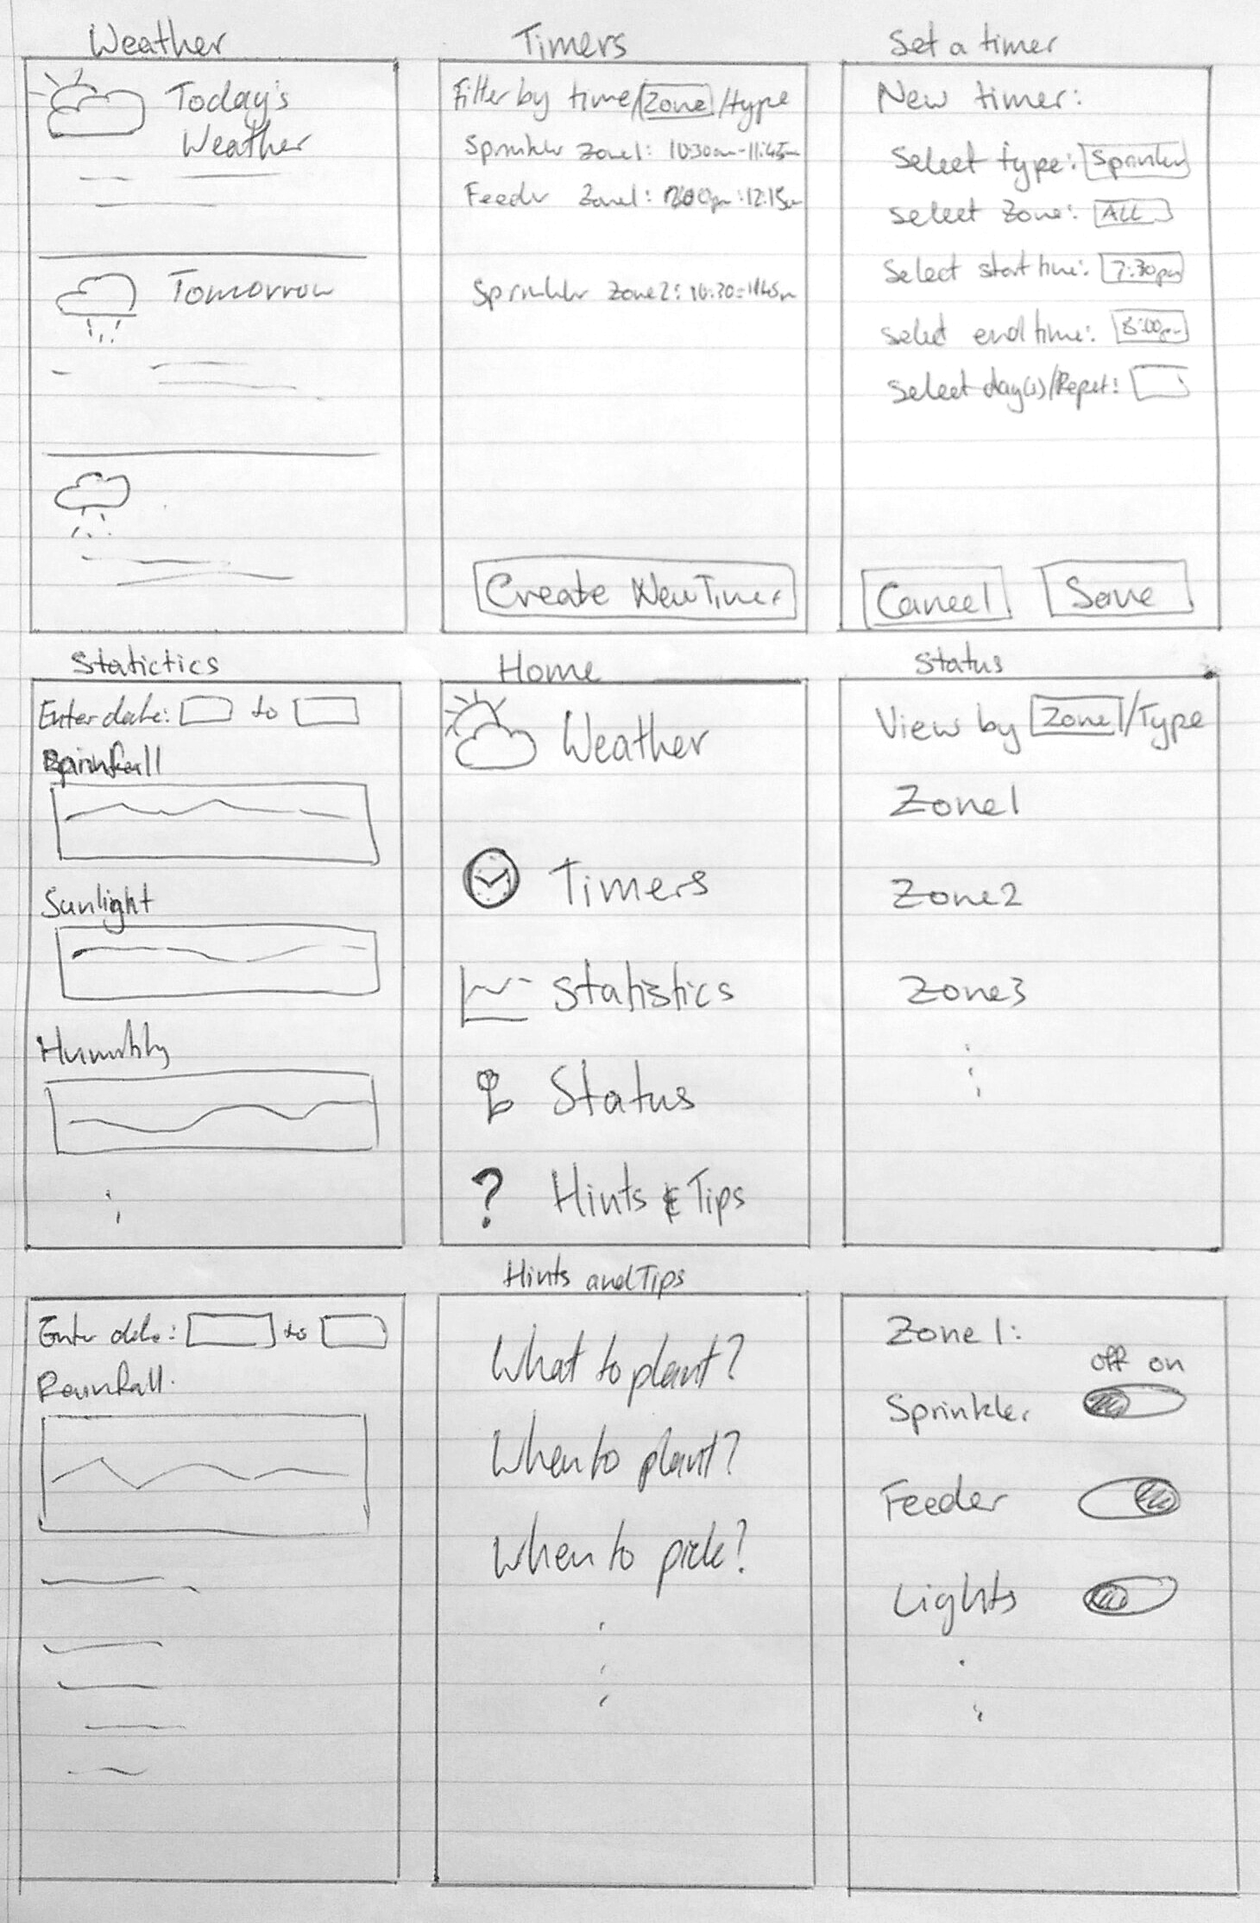
Preliminary Design Alternatives - Design 4
Can view timers by time, zone or type.
Long press on a timer to go to deletion, and ‘x’ appears next to the timer. Click on ‘x’ to delete timer, otherwise clicking all other areas will exit deletion mode.
Create new timer goes to new timer screen.
The weather screen shows basic three day weather forecast, includes details like temperature and humidity.
Clicking en enter the date square produces a pops up a calendar.
Clicking on a graph goes to page with more statistics.
From the home screen can go to weather, timers, statistics, status, and hints & tips
Able to view the status of the components by zone or by type.
Clicking on a zone/type goes to page with all the relevant items which can viewed and switched on or off.
The hints & tips screen gives the users advice on maintaining their garden. Clicking on a hint/tip goes to relevant webpage.

Slide 16
Preliminary Design Alternatives - Design 4
Pros | Cons
Can see statistics to/from custom date User chooses whether to view stats by type or by zone User can set timers for sprinkler system and other components in the garden Simple home screen with listed features of app | Lack of back buttons A lot of clicks to get to get want the user wants The filters may be a bit confusing to first use Can only view statistics by type, not zone Can’t set all sprinklers to on/off at once Status name is confusing, intuitively name seems informational, rather than turning on/off functions
Risks: could forget about sprinkler timer over rainy period when it is not needed.
This design would be good for scenario 1 because Steve would be able to set timers for sprinklers/etc so he doesn’t have to closely monitor the garden.
This design would be not so good for scenario 5 because Lucy wants to be able to predict things with help from the weather
It would be bad for scenario 6 because the statistics feature lacks categorising information that the students want.

Slide 17
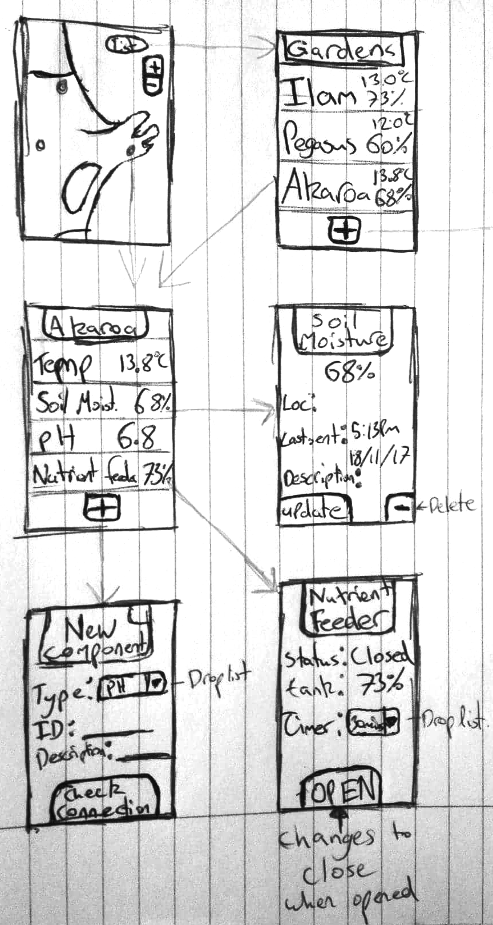
Preliminary Design Alternatives - Design 5
You can select a garden/zone from map, or switch to a list of the gardens. +/- to zoom in/out
Overview about the garden. Can add components or check info use components from here
Describe soil moisture/ component overview
Adds component after successfully testing connection
Shows if feeder is open, and you can open it for an X time period

Slide 18
Preliminary Design Alternatives - Design 5
Pros | Cons
Easy to access garden overviews Simple design Easy to add and remove components Able to see if components are still connected | Basic overview of each feature at given location - not much detail available Lack of statistics, data logging, timers, controlling of physical components (ie sprinklers) Not intuitive for first time learners
Risks: No way to schedule or delay watering timers, so requires app access at these times.
This design would be good for scenario 4, as Mary would benefit from the simple UI, and the ability to see basic information about the garden easily.
This design is also good for scenario 6, as the children would be able to set it up themselves, and would require minimal input from the teacher to operate all its functions.

Slide 19
Primary Preliminary Design: Explanation
By analysing the pros and cons of each alternative design, the best design concepts have been selected and combined to produce a primary preliminary design, as well as to create new components to the application. The primary preliminary design explanation below indicates from which preliminary design alternative (Design 1 - 5) a feature has come from or whether it is a new concept.
The final Home screen will show the weather forecast for today (Design 2), if clicked on it links to the daily forecast for the future as well as the past (Design 1). There will be reminders that can be dismissed by swiping them across the screen (new) and suggestions for the best time to plant things which will include a link to the specific guide in the Hints and Tips section and can also be swiped to dismiss (new).
There will be a sidebar menu present on every screen in the app (Design 1), which displays a picture of each section that can be clicked on, and if the top ‘menu’ icon is clicked the sidebar slides out to cover most of the current screen and shows the names of the different sections next to their icon (new). The order of the sections in the sidebar menu have been determined through the task frequency analysis, making the most frequently used sections closer to the top and therefore easier to access.
The Controls section will show the all the settable components of the garden (ie sprinklers, feeder etc) and their current state (Design 4). The user can choose whether they want to view the controls by zone or component type (Design 4). Each control has a switch to turn the component on and off, and some components also have a slider (Design 3), for example to control brightness of lights or heating level. The screen will be divided into collapsible portions for easy viewing and quick access to specific attributes (new).

Slide 20
Primary Preliminary Design: Explanation
The Statistics section will show the user sensor information. The user can view the statistics by zone or type and can also view different time periods by choosing daily, weekly or monthly view (Design 2). Similarly to the Controls section the screen will be divided into collapsible portions for easy viewing and quick access to specific attributes (new).
In the Timers section the user can control the timers for the components in the Controls section. The user can set timers for when they want their sprinklers to go off etc and they can view their current timers by their choice of time, zone or type of component (Design 4). The user can also add conditions to their timers to specify for example if they want the sprinklers to not turn on if it rained that day (new). Similarly to the statistics section, the screen will be divided into collapsible portions for easy viewing and quick access to specific attributes (new).
The Log section will feature a calendar view with the days shaded proportionally for the amount of events logged on that day (new). When a day is clicked the events that were logged on that day will be shown (Design 1), and new events can be added on either the day or the month view. A reminder can be set when creating an event so that, for example, 4 months after planting carrots the user will get a reminder to harvest them.
In the Hints and Tips section there will be different guides for gardening tips and information about specific plants (Designs 1, 3 and 4). It will feature different guide categories that when clicked on will take the user to a list of all the different plants relating to the category they chose. They can then click on the specific plant they want to know about and the information is displayed to the user as a scrollable pop up (new).

Slide 21
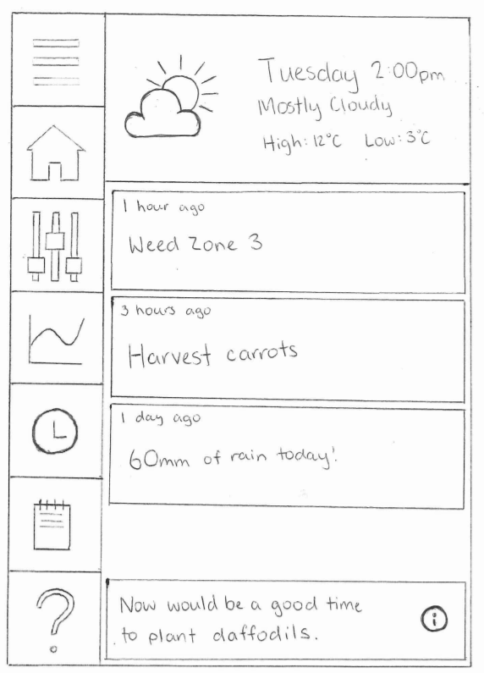
Primary Preliminary Design: Home
Menu button
expands menu
Home button
Controls button
Statistics button
Timers button
Log button
Hints and tips button
Clicking the weather section takes the user to an expanded weather forecast (on next slide)
Notifications can be dismissed from the home screen by swiping them sideways. If the notification is a reminder, pressing it will go to the relevant log page. If notification is a status, pressing will go to relevant statistic page.
Can vertically scroll through the notifications.
Occasional notifications from hints and tips section that pop up as suggestions, and is pinned to the bottom of the screen. Can swipe to dismiss or click the (i) to go to the guide section for the plant in the hints and tips section (eg daffodils in the flower guide in this case)

Slide 22
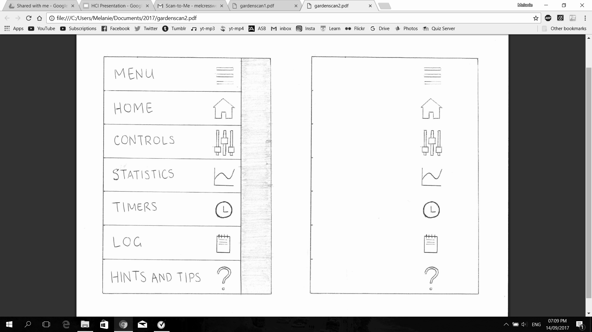
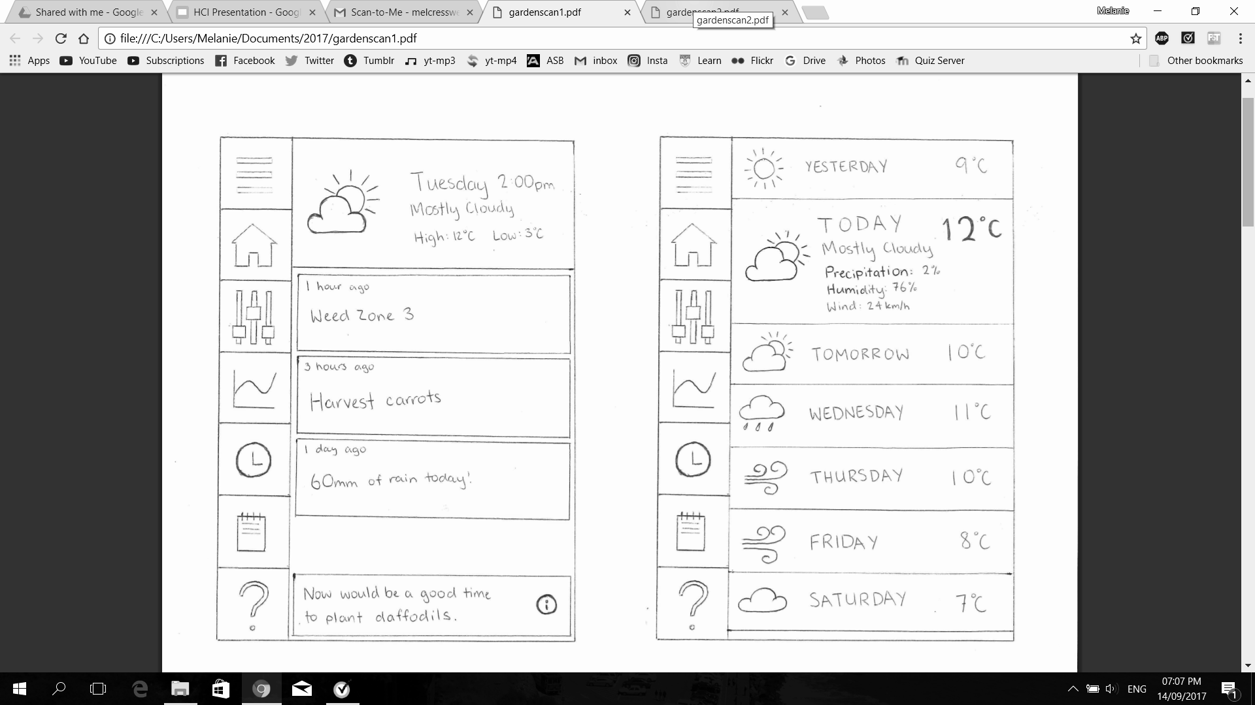
Primary Preliminary Design: Menu and Weather
If menu expander is clicked the menu slides out from the left and the names of each button can be seen.
To minimise menu expander user can click menu button, the shaded bit on right, or swipe left.
Weather forecasts can be expanded by clicking on a specific day.
When another day is clicked the current one contracts.
Today’s weather is expanded by default when viewing homepage.
Can vertically scroll to get previous and future forecasts.

Slide 23
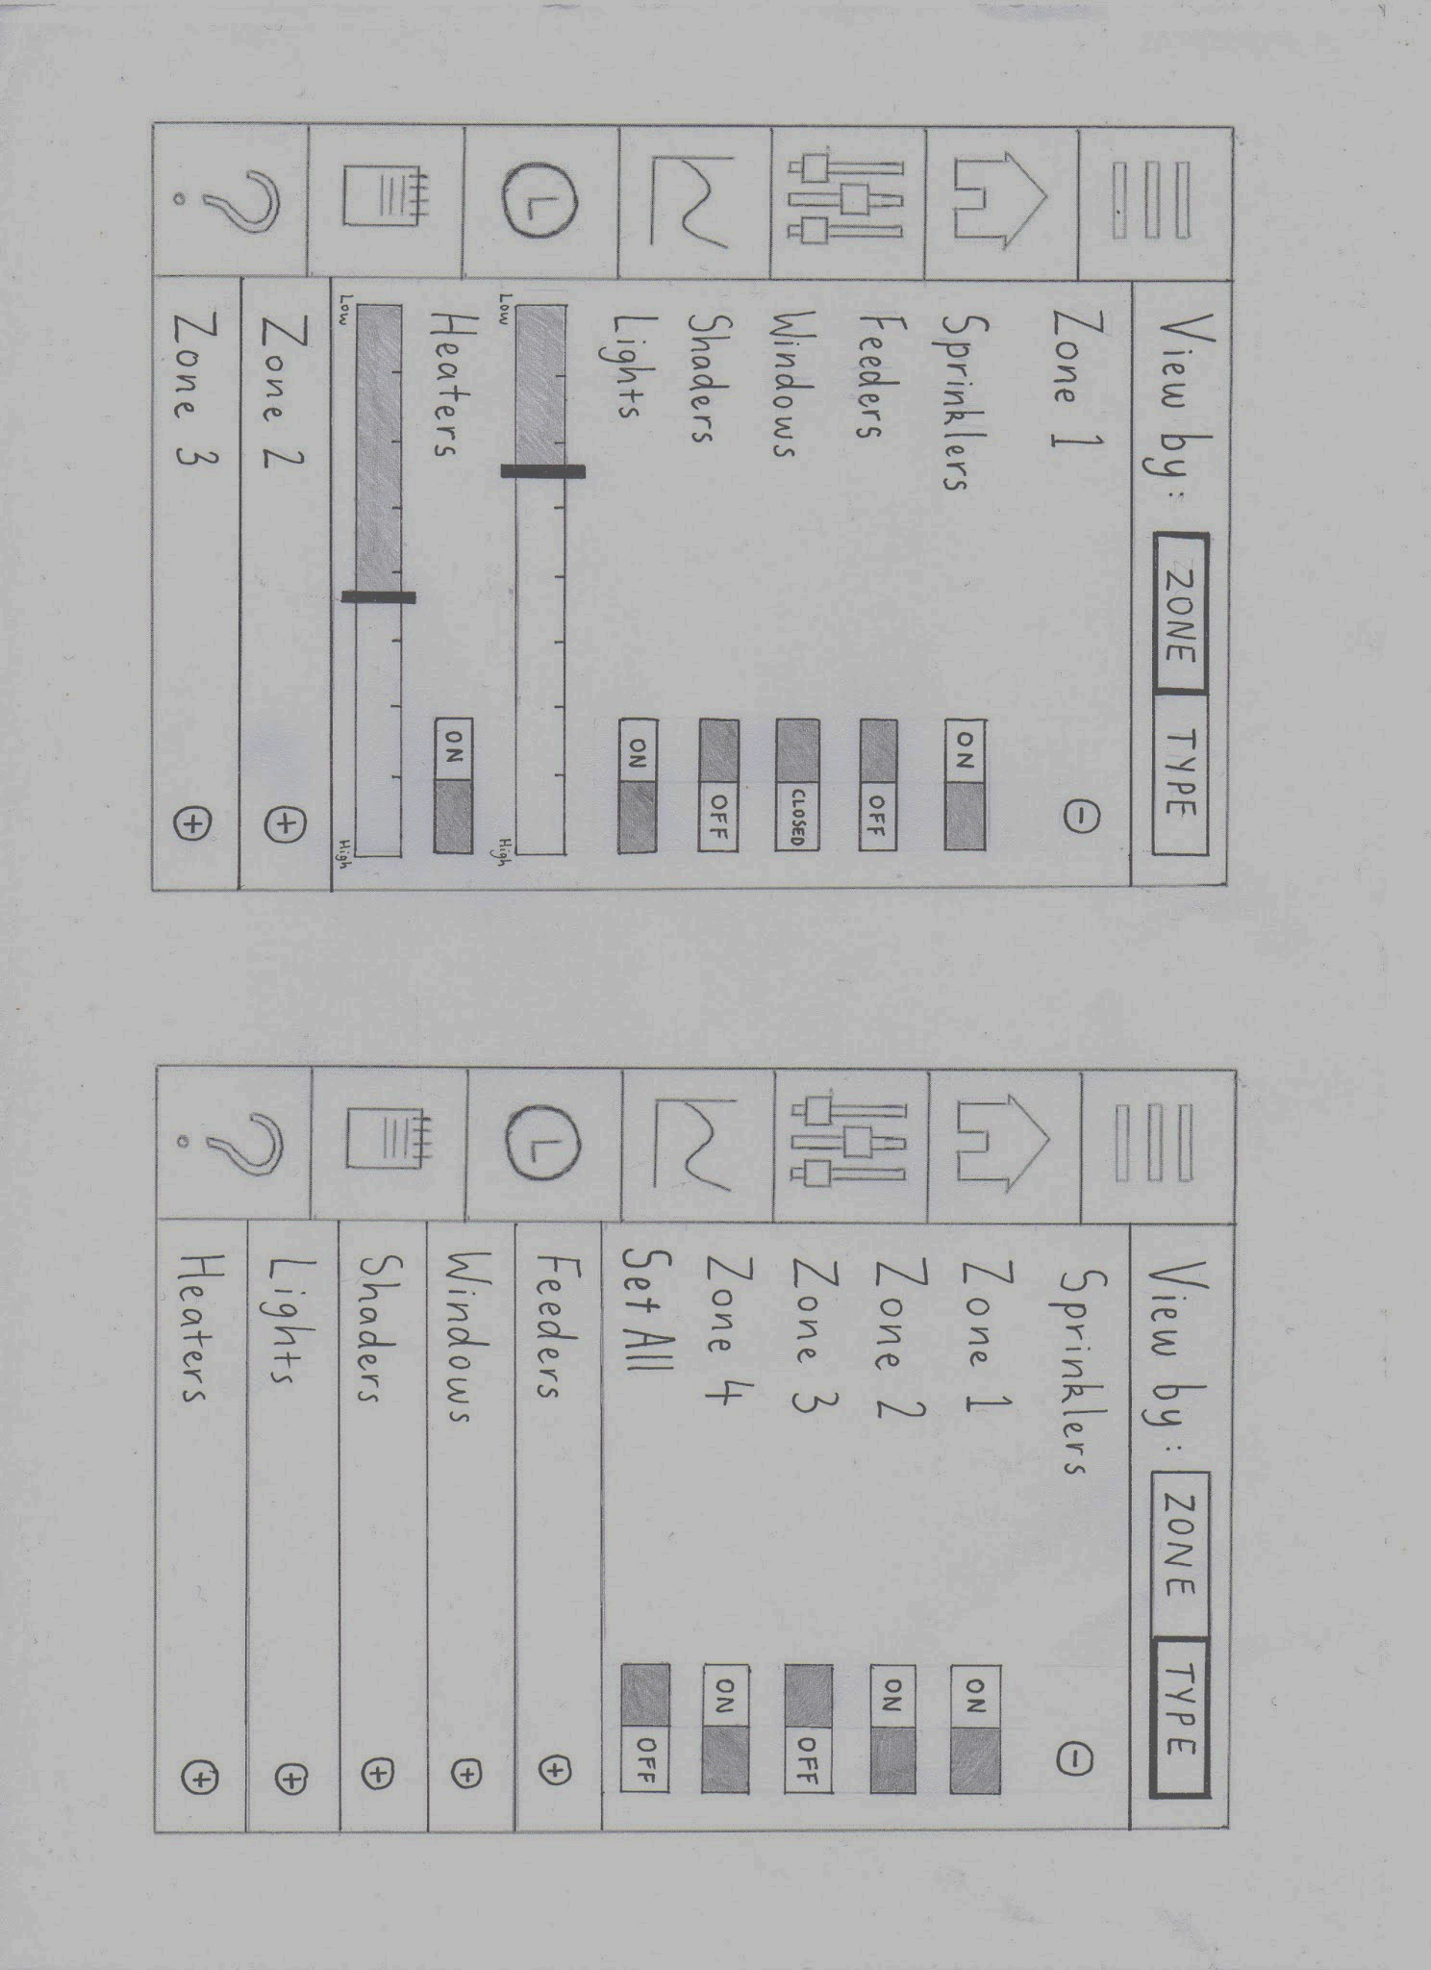
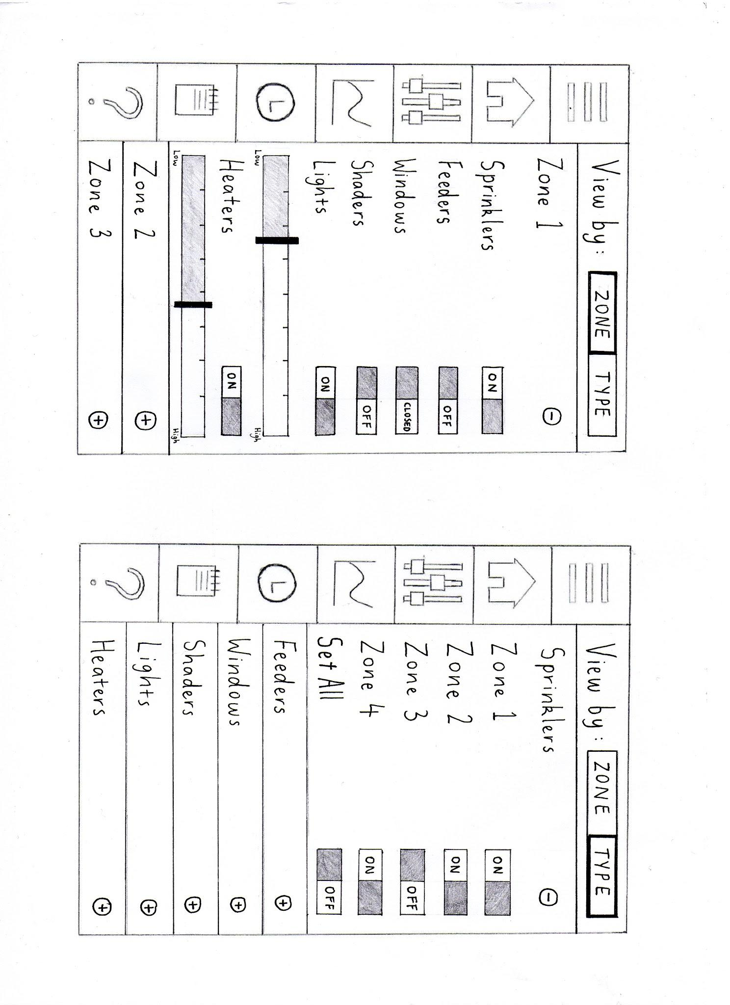
Primary Preliminary Design: Controls
Able to view components by either zone or type.
When lights/heater is turned on, the relevant slider appears below it. Disappears when turned off.
The zone/type sections are expandable by pressing the ‘+’ symbol and can be minimized by pressing the ‘-’ symbol.
When viewed by type, user can use one slider to turn on/off all, or individually by zone.
Can vertically scroll when multiple sections are expanded.

Slide 24
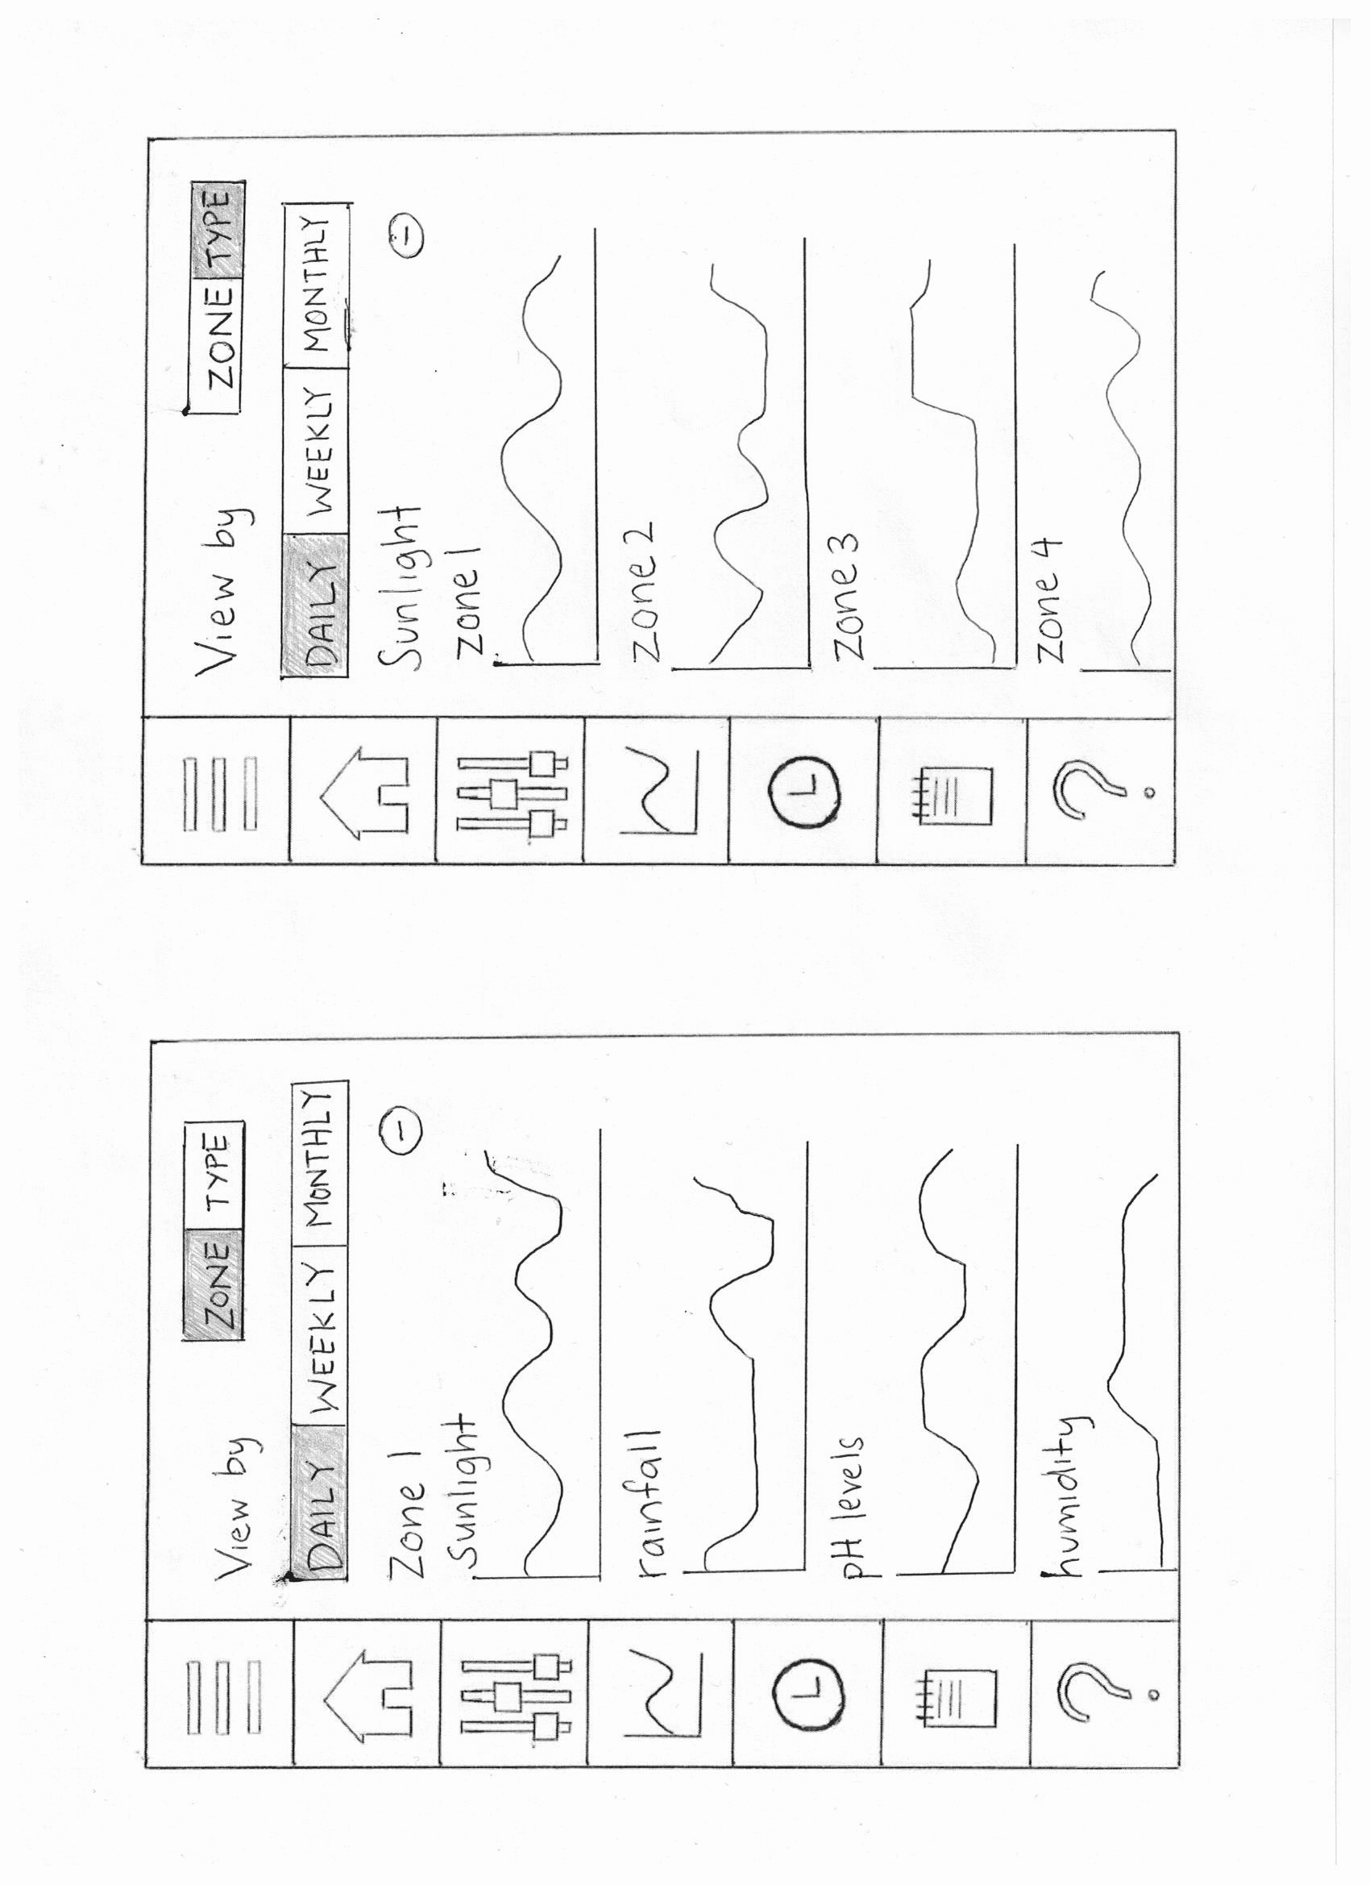
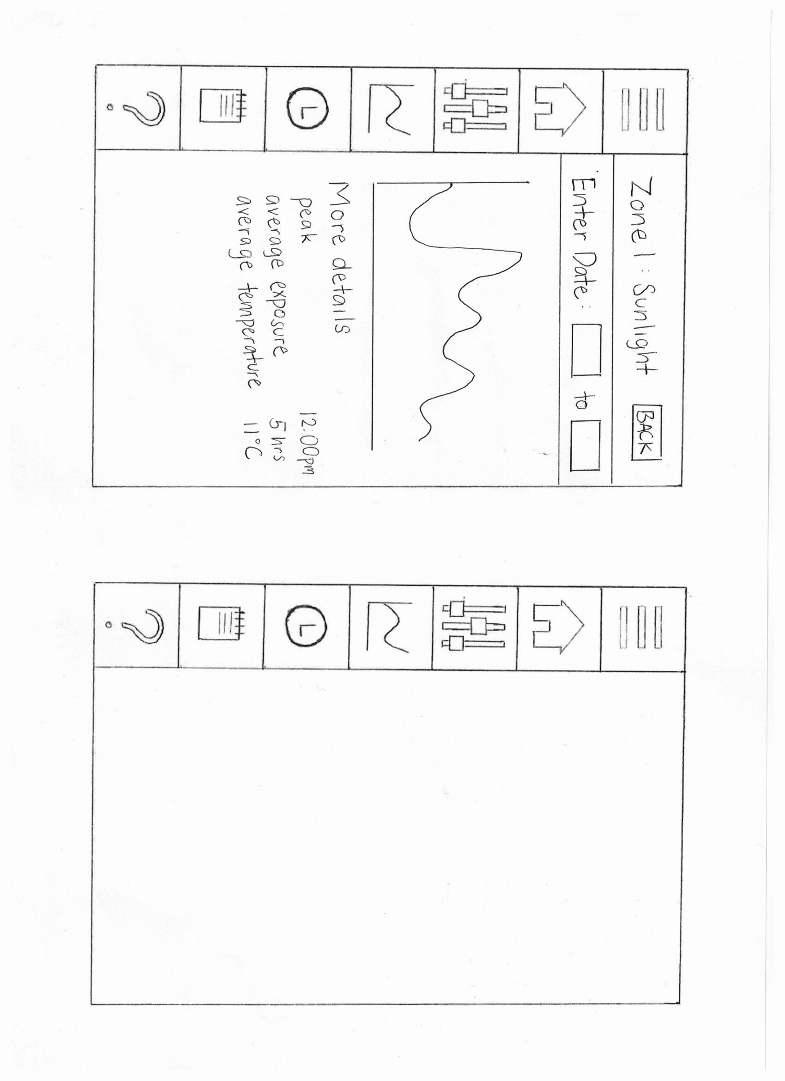
Primary Preliminary Design: Statistics
Back button on screen below returns to previous page
Users are able to minimize each zone/type to easily view and get to the zone/type they want, by pressing the ‘+’ and ‘-’ symbols. Able to vertically scroll to see more of the components.
Users are able to view the statistics either by zones or type and can choose daily, weekly, monthly versions.
When a specific graph is clicked on it goes to a separate page for more details (details will differ per type). Users are able to specify a date range, when each box is clicked a calendar pop-up will show on screen for users to select a date.

Slide 25
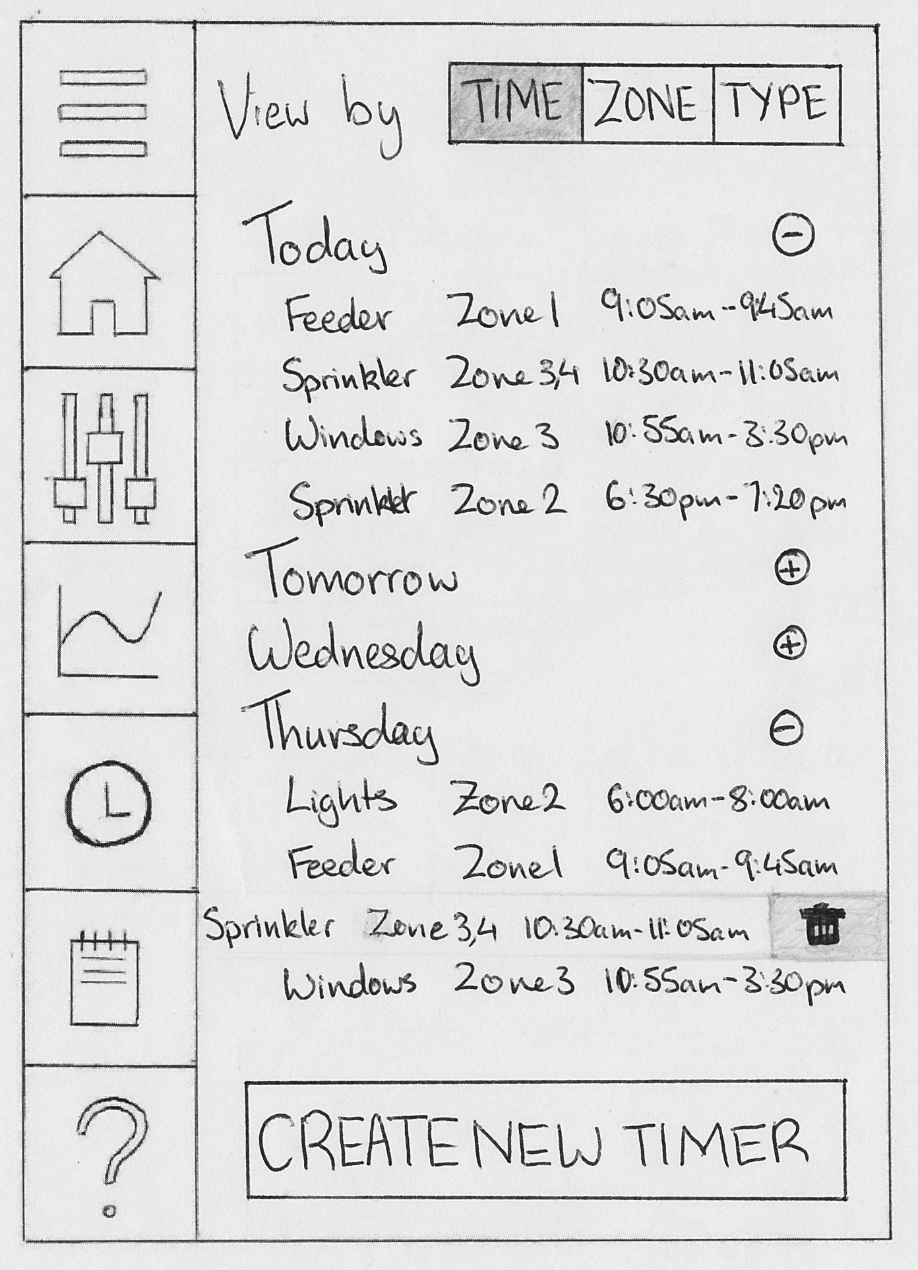
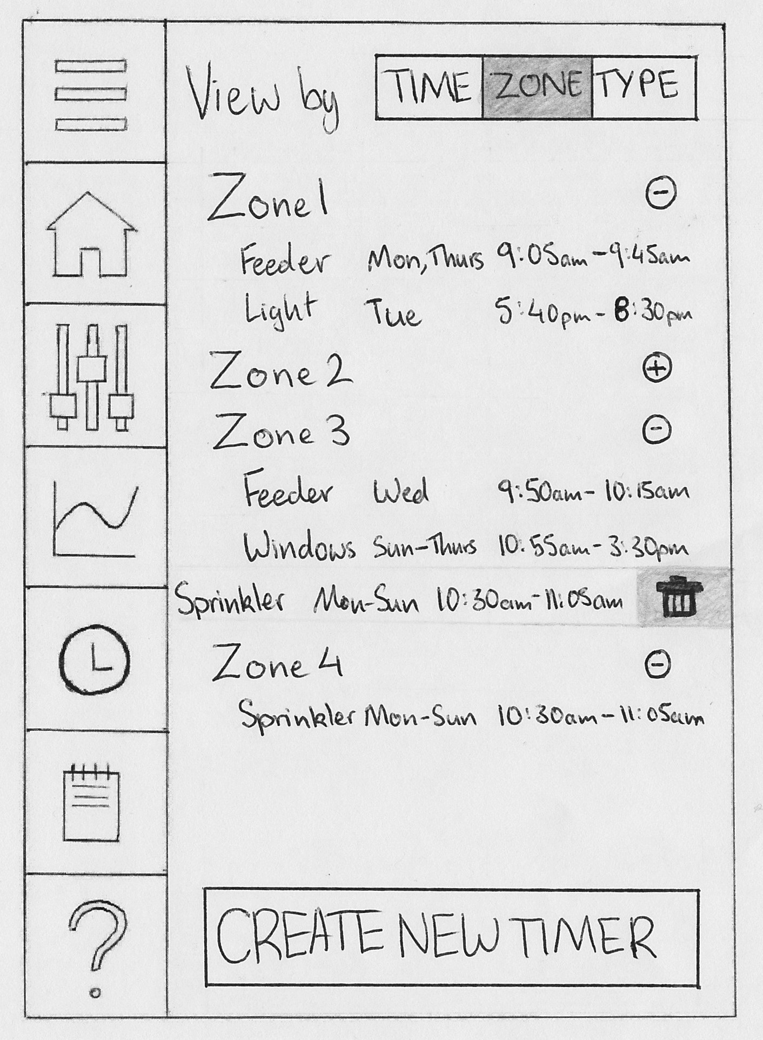
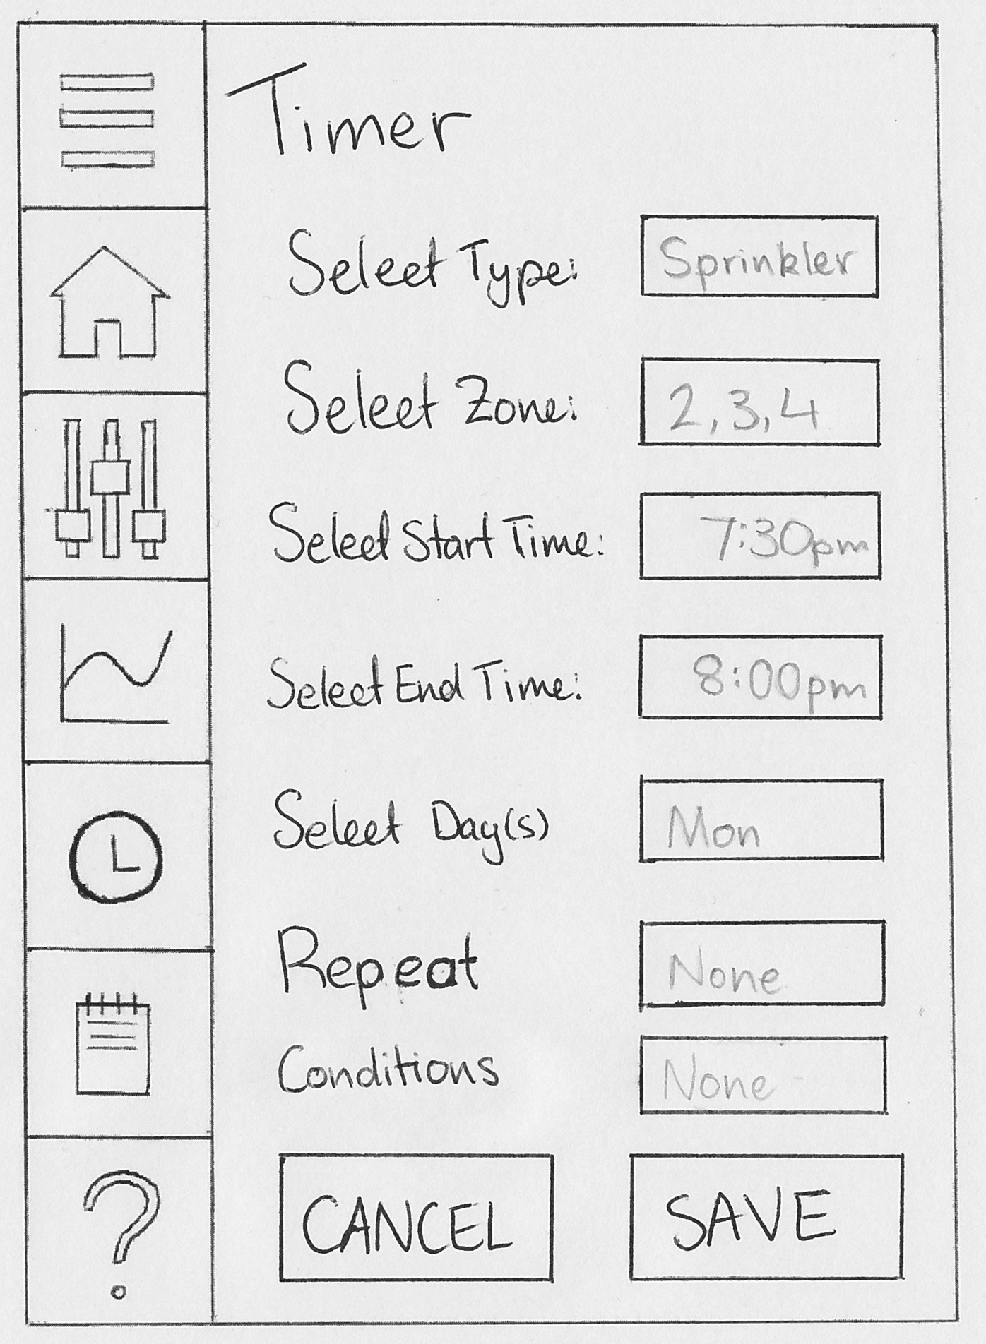
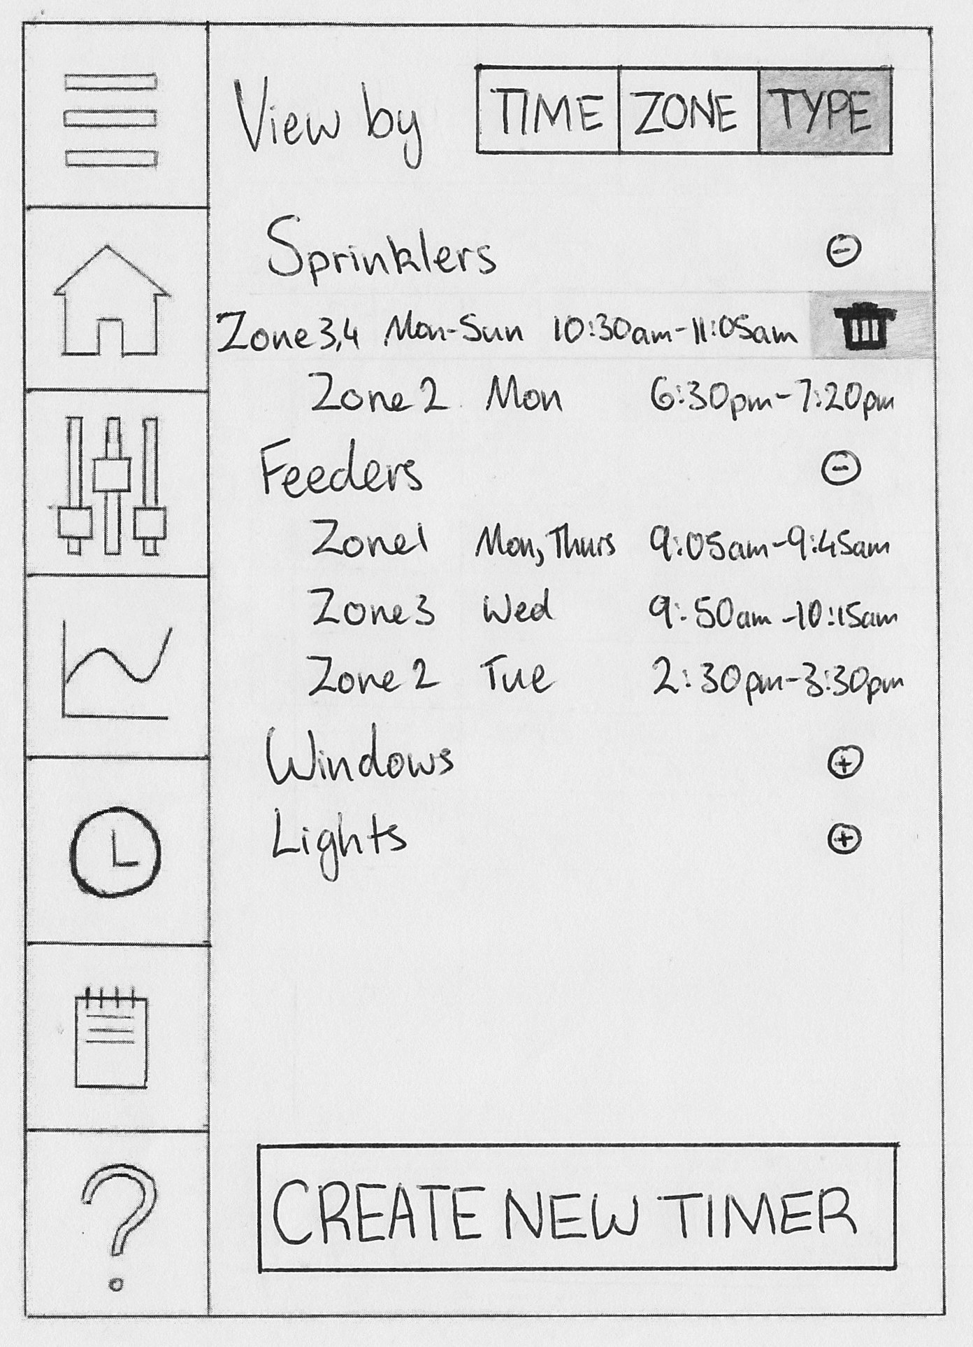
Primary Preliminary Design: Timers
Tapping a timer goes to an edit screen. Swiping left on a timer gives option to delete the timer.
Able to view all timers by either their time, zone, or type.
Minimize and maximize timer details by pressing ‘+’ and ‘-’ symbols.
Can set up conditions such as “don’t turn on sprinkler if it rained last night” on a timer.
The timer screen is used for creating a new timer and for editing an existing timer.

Slide 26
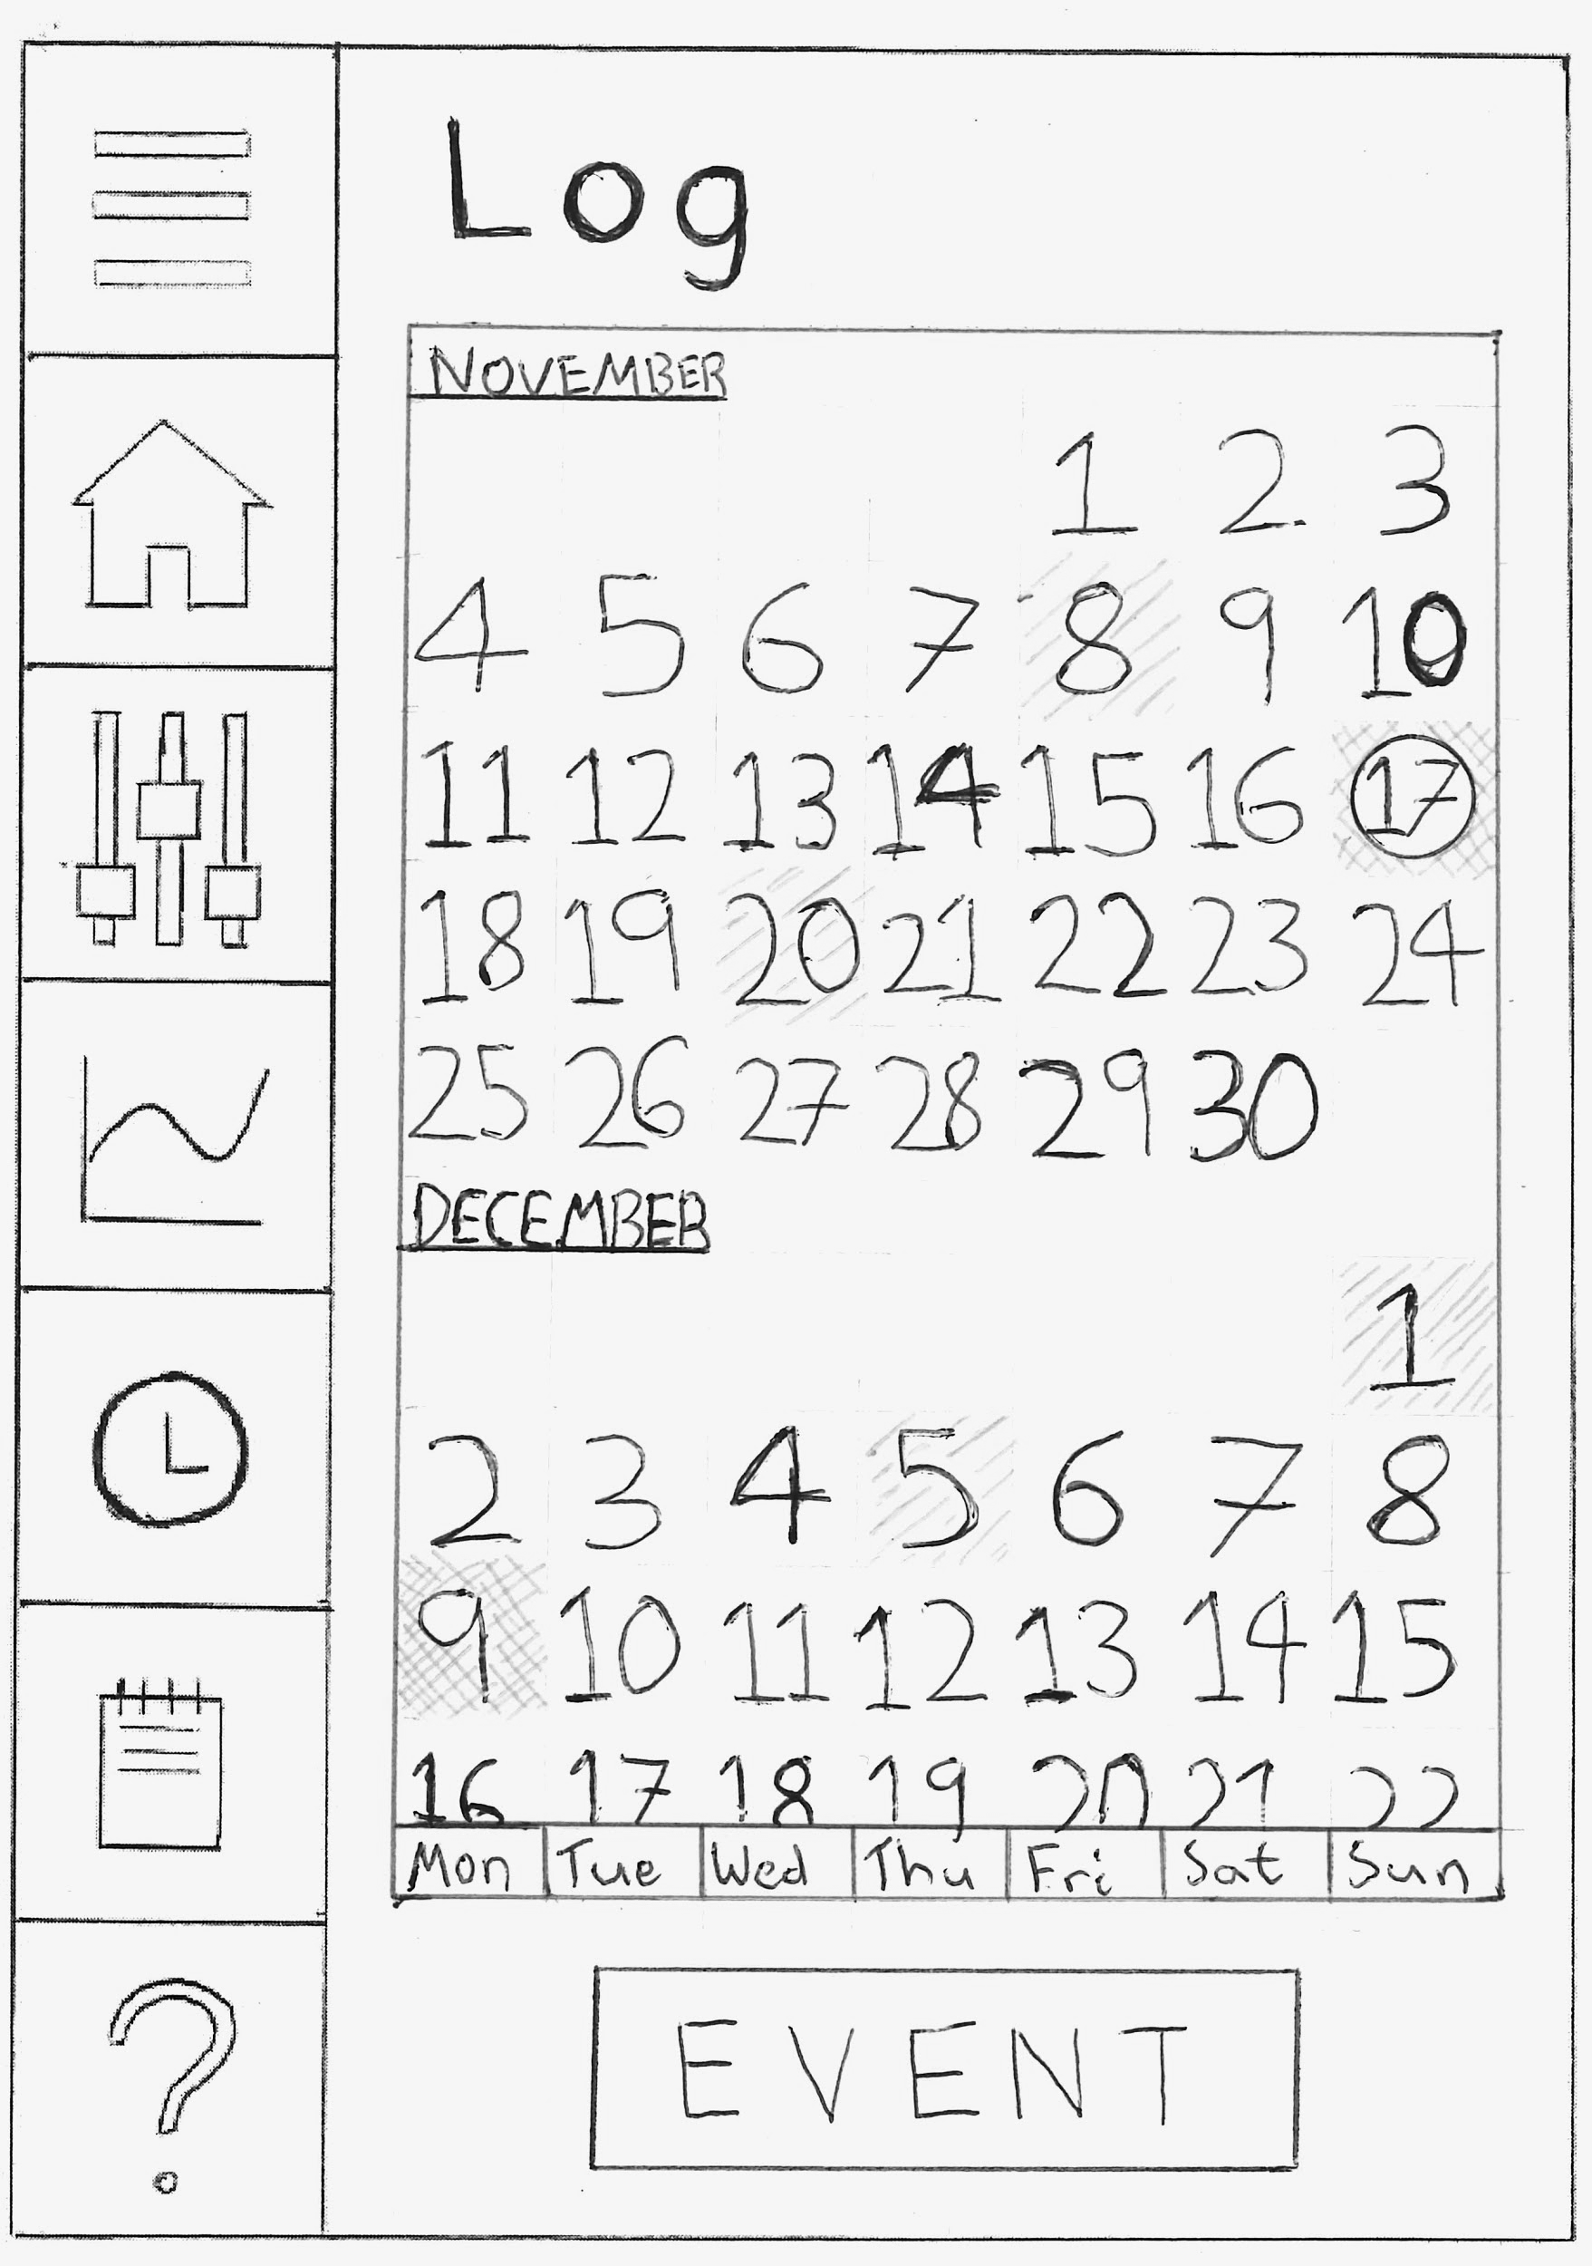
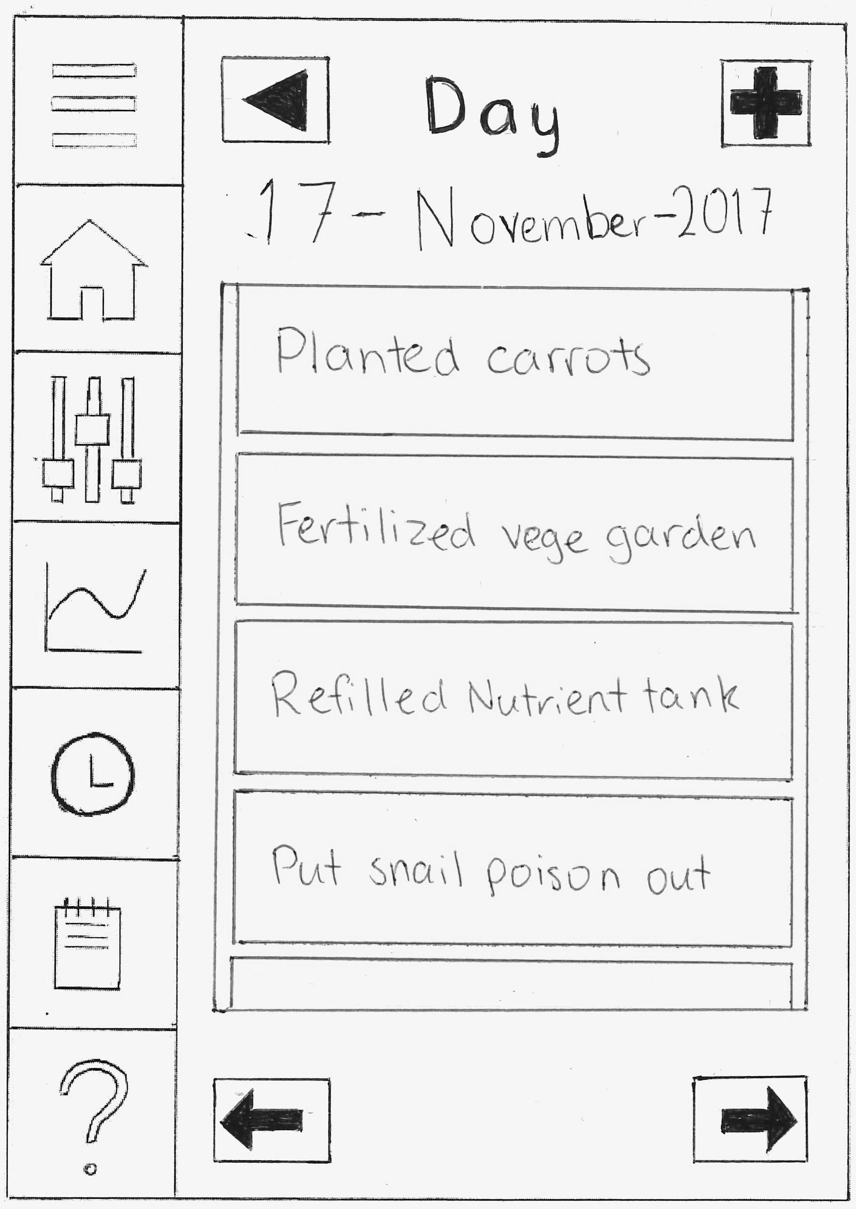
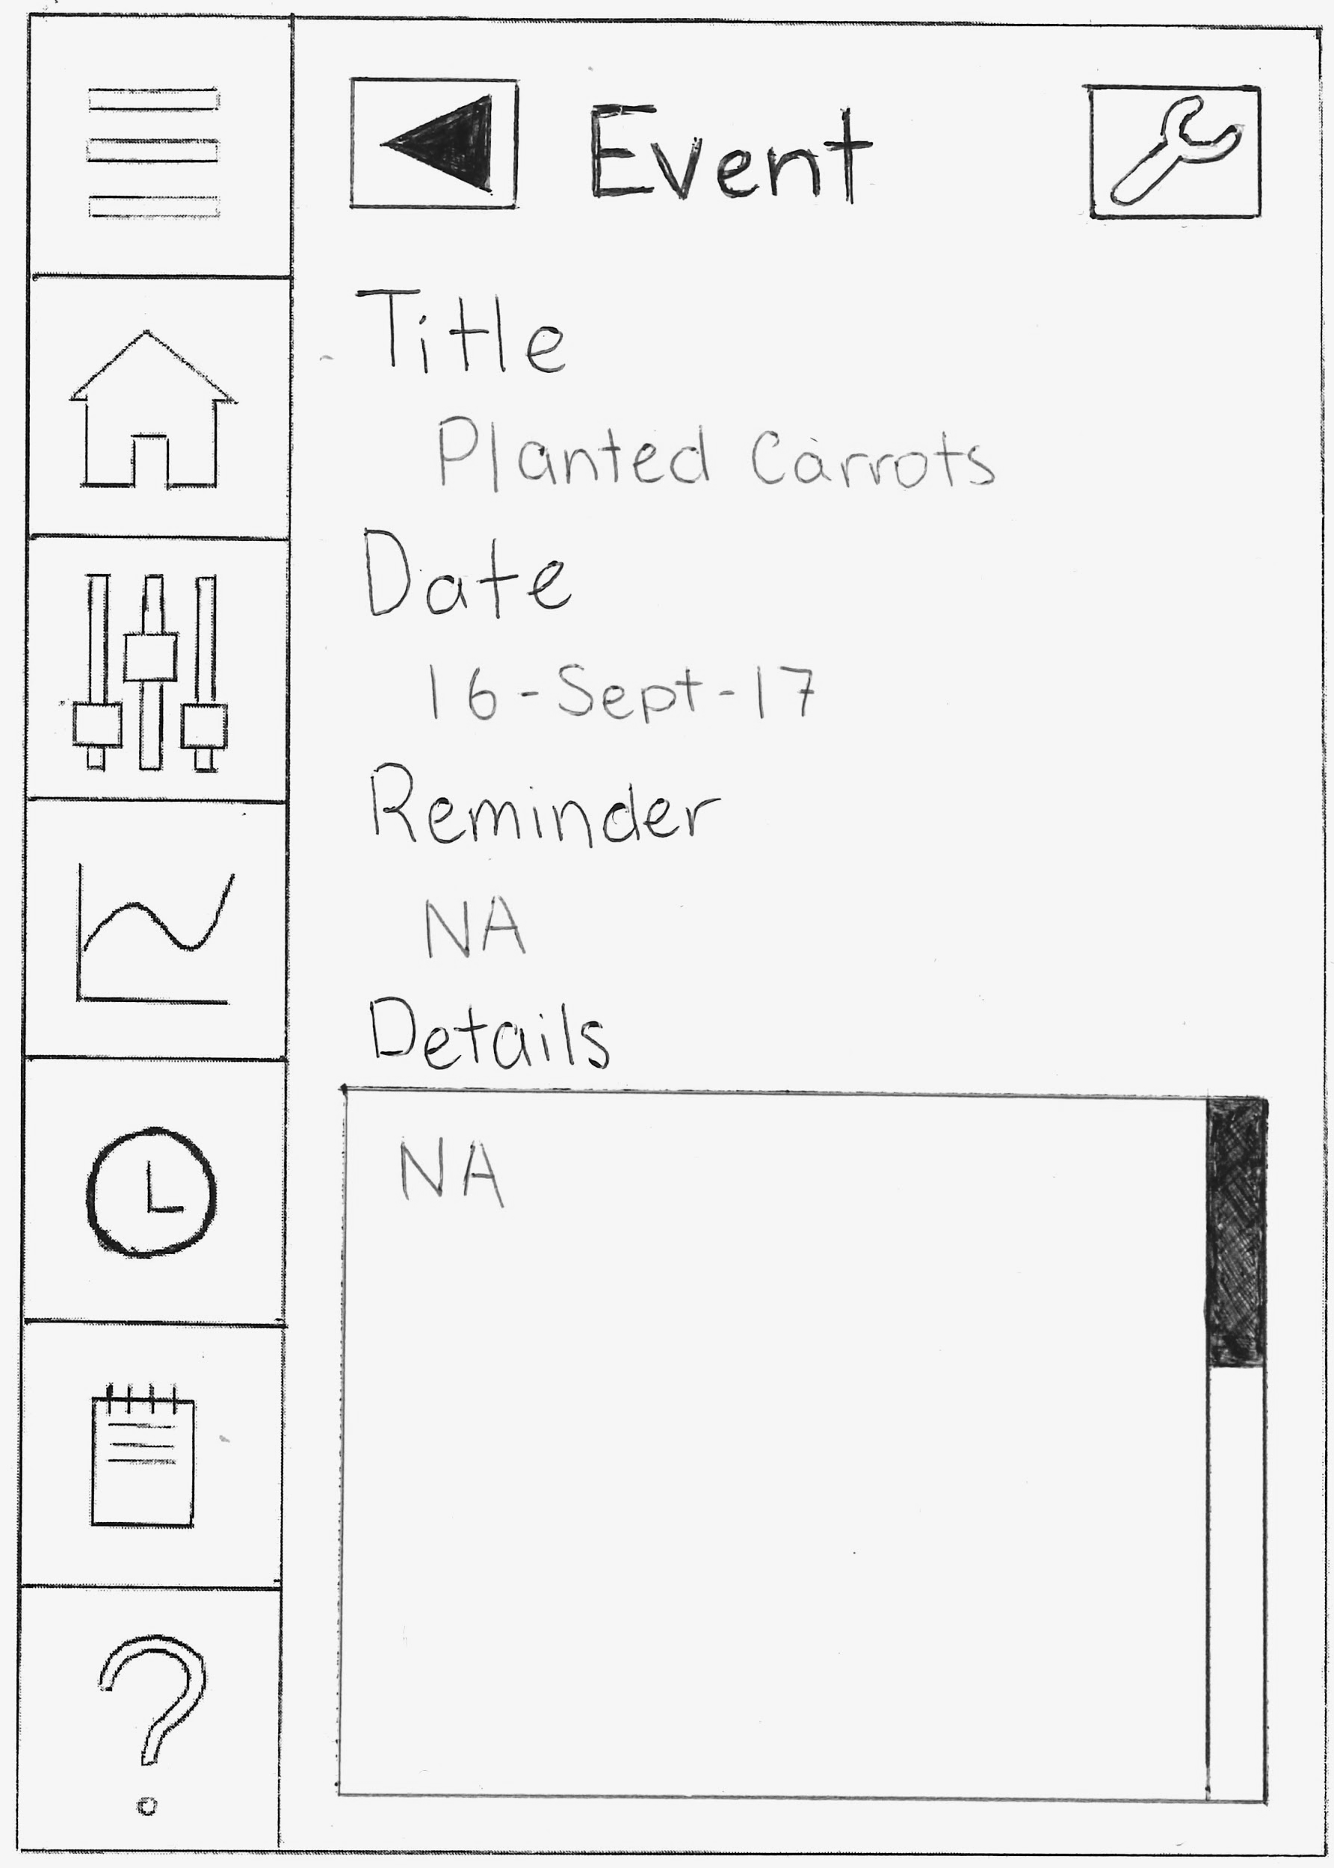
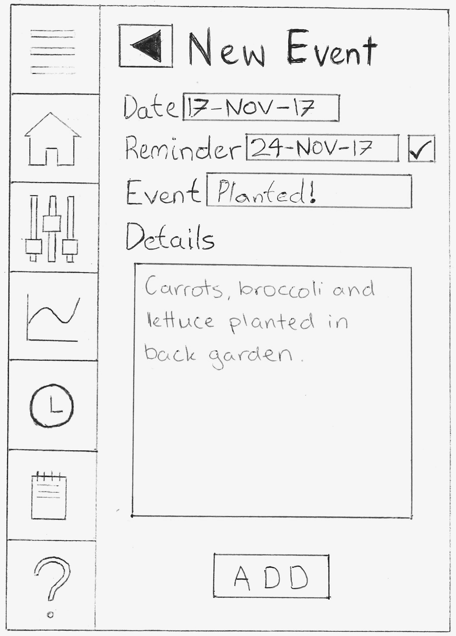
Primary Preliminary Design: Log
Shaded days in proportion to number of events on each day. Circle around today’s date.
Clicking on a specific day takes the user to list of events for that day.
Clicking on a specific event takes the user to the event details.
Clicking the spanner gives the user the option of either deleting the event or editing it.
Option to set a reminder via the checkbox next to the reminder field.
Clicking the event button takes the user to the new event page.
Arrows to scroll through days

Slide 27
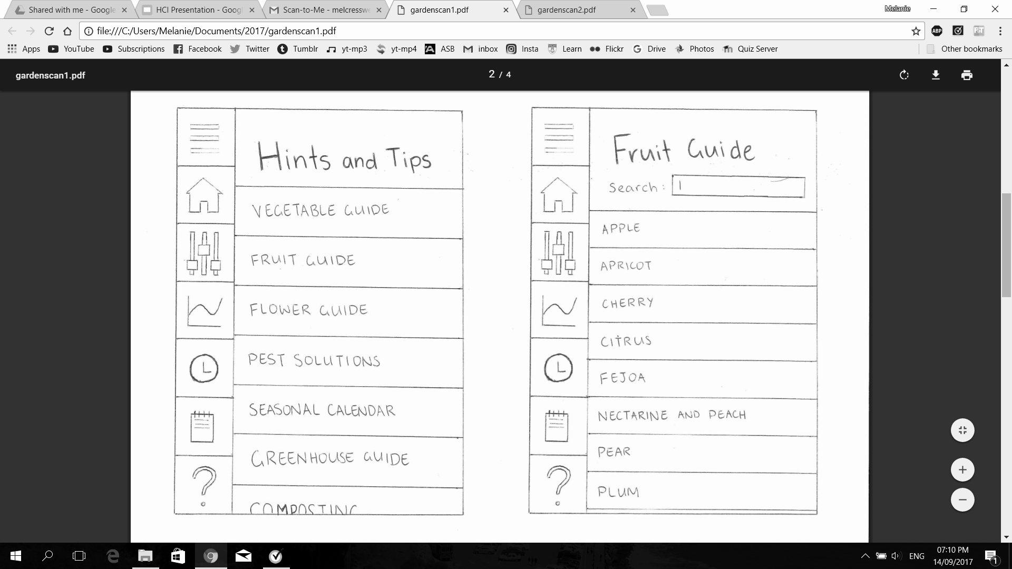
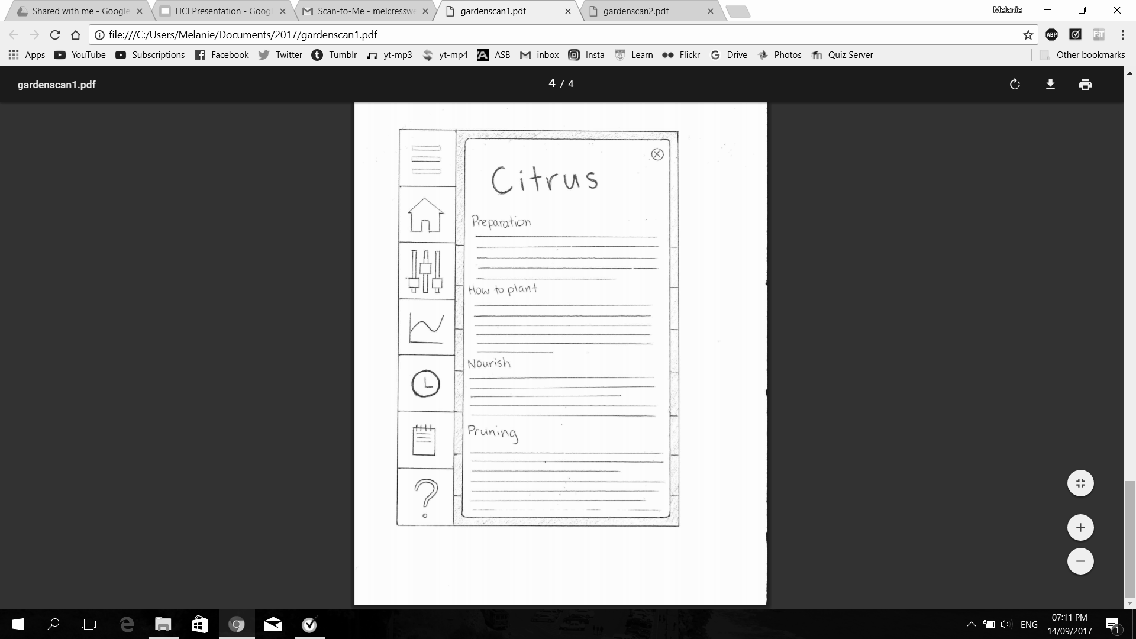
Primary Preliminary Design: Hints and Tips
Search bar makes it easier for users to find the information that they are after. Each page is vertically scrollable.
Each guide opens to another page with relevant information relating to the selected category. This allows users to quickly access relevant information to the plants.

Slide 28
Conclusion
This presentation has shown the concepts used in the design process to produce a primary preliminary design for the REMIT 10 Inc. SmartGarden App. In order to produce a design that satisfies the needs and wants of the varied users, an analysis of user tasks was carried out prior to the sketching process.
The first step of this analysis was to create realistic and accurate scenarios to reflect a number of situations that potential REMIT 10 customers may be faced with and the tasks they wish to complete when using a smart-garden application. Based on the design brief and scenarios, a list of tasks that are important to the user was created and categorized by relevant elements (water, air, light and soil) and topics (information). This list of tasks was analysed and ranked on how frequently the user would carry them out and how important they are to the user, in order to establish which features should be prioritised in the design sketches.
Following the frequency analysis, each team member of Better Solutions™ produced a preliminary design alternative. These five designs were evaluated, with the relative merits of each assessed and summarized into a list of pros and cons. Each design was also measured on how successfully it achieved the requirements set in the user scenarios, and the risks the user may encounter when using them.The best design concepts from each alternative design were selected and combined to produce a primary preliminary design which satisfies all tasks and user scenarios determined earlier in the process.
In the process of producing this primary preliminary design, multiple stages of development were carried out which involved discussion, comparison and collaboration. The following design features demonstrate some of the adjustments made through this final process:
Originally the menu shortcuts were considered to be on the right hand side of the screen, but this was later changed as having it on the left seemed more practical and may reduce accidental clicks on the shortcuts as the left side is harder for right-handed people to accidentally click.
The order of the menu options was considered with the rationale of what components the users think are important and what are they likely to use frequently.

Slide 29
Conclusion (continued)
The name of the controls feature was originally Status but this was changed since the words Status and Statistics are very similar to each other which may confuse users. Also status intuitively seems to be more informational whilst controls intuitively makes users think that they can change or modify something if they click on that page.
Easily accessible shortcuts on each page via the menu bar increases usability for the consumers, and whilst learning they can click on the top left shortcut to see the linked page names to increase learnability for those new to the app.
The app was made as user-friendly as possible with coherent designs throughout the app, icons to attract users and buttons being distinguished from other texts using full uppercase letters on all them. Also expansion/contraction buttons help usability for consumers by decreasing the amount of scrolling they need to do to get to specific part of the page they want.
The app was made easy for first time gardeners by including the hints and tips feature to encourage skill and knowledge development.
Reminders on the home page make it easy for users to plan/remember gardening tasks, increasing the usability by alerting users of tasks they need to do in order to maintain a healthy garden.
RISK - there is potential users to forget to delete their notifications on the homepage, which could make it easier to accidentally click one of the reminders and be transferred to the linked page when they didn’t want to, so users need to manage their own notifications.
RISK - there is potential for the app to use a lot of memory space on the device with the need to download the information for hints and tips in order for users to be able to access this function offline.
Overall, Better Solutions™ has produced a design that puts users requirements first, while maintaining a simple and functional application. Through incorporating REMIT 10 Inc’s patented smart protocols, this application design will provide the company with a competitive advantage in the emerging smart-garden market.

Slide 30
Team Contributions
Mel Cresswell: abstract, task identification, categories of tasks, scenarios (1, 3, 6), preliminary design 1, pros and cons of each design, final design plan, final design sketches (home, menu, weather, hints and tips) and descriptions, conclusion
Isabelle Lynch: abstract, introduction, executive summary, task identification, scenarios (2, 5, 6), preliminary design 3, pros and cons of each design, final design plan, final design sketches (controls) and descriptions, conclusion
Nicole Steinke: abstract, task identification, scenarios (1, 2, 3, 5, 6), preliminary design 4, pros and cons of each design, final design plan, final design sketches (timers) and descriptions,
Alexis Sy: task identification, importance of tasks, scenarios (4, 6), preliminary design 2, pros and cons of each design, final design plan, final design sketches (statistics) and descriptions, conclusion
Thomas Eatson: abstract, task identification, scenarios (1, 3), preliminary design 5, final design sketches (log), conclusion

